Slide 1


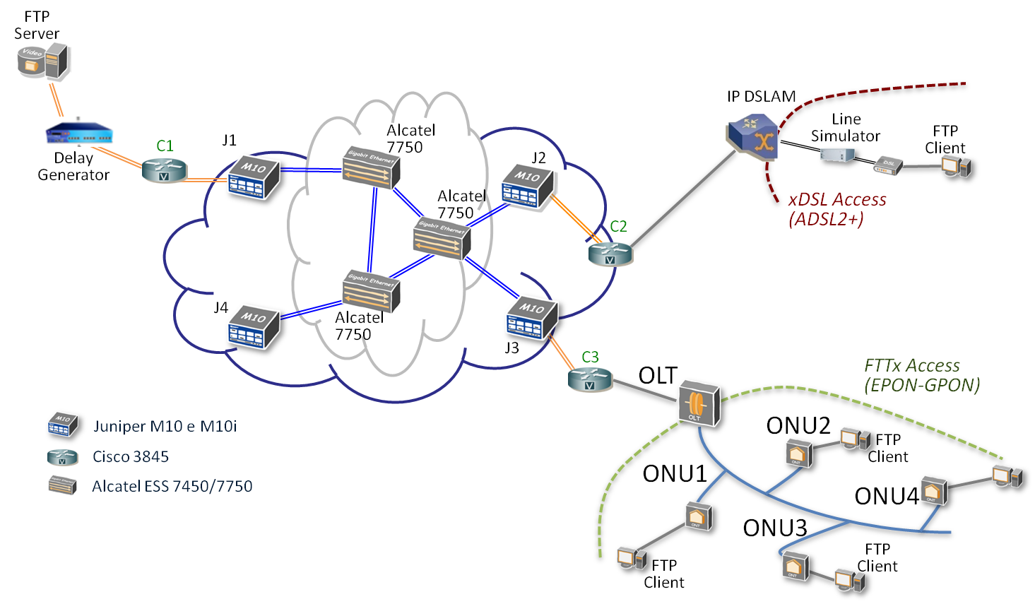
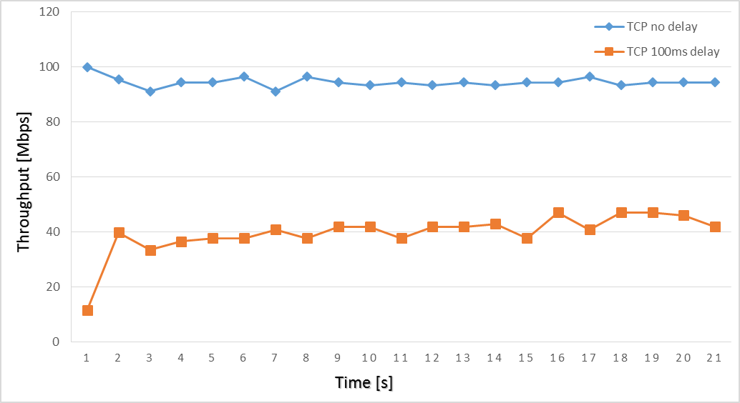
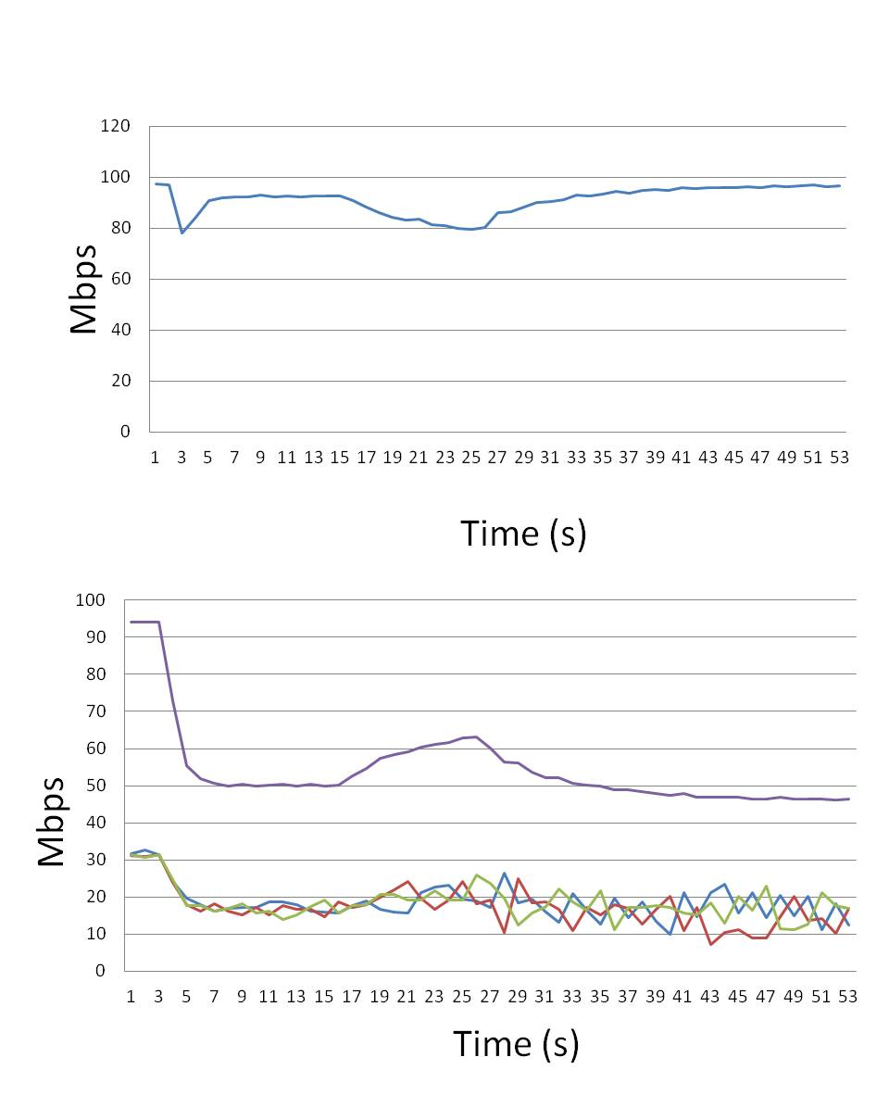
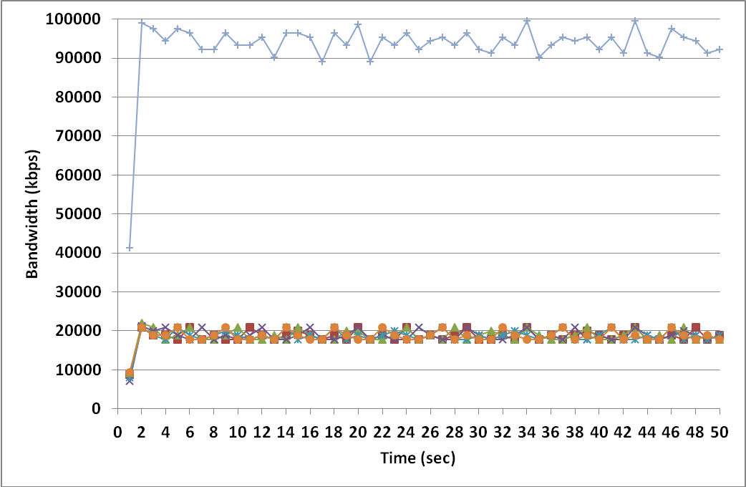




SLA Verification and certification
Role of SLA in future networks and its verification and certification
Novel SLA can be defined according to the Services with implications at different stacks of the OSI Layer.
Not only bandwidth between ISP and Clients; for an instance QoE from Content Providers.
Verification and Certification of bandwidth delivered by the ISP (Layer 2 OSI)
Application SLA (ASLA) Verification and Certification (Layer 7 OSI)
Necessity of a client probe (active) to verify and certificate SLA at different OSI layers (2, 4 7). Currently Speed tests (based on TCP) only verify at layer 4 (or 7).
mSLAcert is the first active probe able to certify bandwidth at: Layer 2 (line capacity), Layer 4 (throughput), Layer 7 (Goodput) + RTT
mSLAcert characteristics and tests
Lab test for mSLAcert
Method
a) RTT test
Throughput test (TCP file download)
Line Capacity test (UDP file download).
Details are in A. Rufini, et al “Multilevel Bandwidth Measurements and Capacity Exploitation in Gigabit Passive Optical Networks” IET Communications 8, 2014, p. 3357 – 3365
In case of test anomalies, by means of MPLANE reasoner, analysis on passive traffic is carried out
Example of Throughput time behaviour for GPON access network Packet loss in case of UDP test
Anomaly tests
Other method for line capacity test: TCP multisesssion
More fluxes in case of network segment bottleneck (bitstream case) Ten 10 Mb/s TCP sessions to exploit the access capacity (100 Mb/s)
E. Tego E. Mammi A. Rufini F. Matera

