Slide 1

Welcome to the 1st mPlane
Industrial Workshop

Slide 2





Organisers
Pere Barlet-Ros
Ilias Leontiadis
Zied Ben Houidi
Maurizio Dusi

Slide 3


Agenda
8:30 Registration and coffee
9:00 Overview of mPlane - M. Mellia, Project Coordinator
10:00 Keynote by J. Cesa, CTO of Zhilabs "Automatic Root Cause Analysis in Convergent networks”
11:00 Break
11:30 Keynote by M. Molina, CTO of Talaia Solutions "Cooperative inter-operator traffic measurement frameworks: technical challenges and barriers for industrial adoption"
12:30 Lunch (joint with PhD school)
1:30 mPlane Architecture - B. Trammell,
2:00 mPlane Live demo - O. Jabr,
2:30 Discussion Panel: Challenges in network measurements and monitoring: an mPlane (and not only) perspective
  D. Papagianaki, C. Diot, B. Trammel, M. Molina, J. Cesar
3:30 Break
4:00 Showroom session: Zhilabs, Talaia Solutions, Radiopt, Callstats.io
4:45 Poster session: mPlane use cases explained
5:30 Wrap-up and final remarks
7:30 Social event
Goal: bring together practical use cases relevant to operators
and providers and discuss topics about proactive and reactive
troubleshooting for network communications at a scale

Slide 4
Attendees
~40% from mPlane
  Polito, NEC,TID, TI, ALU Bell Labs, Fastweb, FUB
~40% from the industry
~20% from academia

Slide 5
mPlane – Building an Intelligent Measurement Plane for the Internet
Marco Mellia
Politecnico di Torino
mPlane Industrial Workshop
April 22, 2015, Barcelona

Slide 6
mPlane project quick facts
mPlane is an FP7 Integrated Project
Project acronym: mPlane
Project full title: “mPlane – an Intelligent Measurement Plane for Future Network and Application Management”
Grant agreement no: 318627
Staring Date: November 1st 2012
Total Cost: 11,274,908.00 €
Duration: 3 years
Partners: 16
Coordinator: Prof. Marco Mellia – Politecnico di Torino - IT

Slide 7



























Who we are
Coordinator
Tech. Coordinator
3 operators
6 research centers
5 universities
2 small enterprises
Marco Mellia
POLITO
Saverio Nicolini
NEC
Dina Papagiannaki
Telefonica
Ernst Biersack
Eurecom
Brian Trammell
ETH
Arpad Bakay
NetVisor
Andrea Fregosi
Fastweb
Dario Rossi
ENST
Fabrizio Invernizzi
Telecom Italia
Guy Leduc
Univ. Liege
Pietro Michiardi
Eurecom
Pedro Casas
FTW

Slide 8
The mPlane community
Many Academic and research institutions come from the Traffic Monitoring Analysis (TMA) COST Action:
  PoliTo, ETH, ENST, Eurecom, UniLiege, FTW, NEC
Some others were part of previous EU projects:
  PRISM: FTW, ETH
  NapaWine: PoliTo, ENST, NetVisor, NEC
  DEMONS: FTW, ETHZ, NEC, TID
  …
A community of network (measurements) experts

Slide 9
Which problem(s) mPlane aims at solving

Slide 10
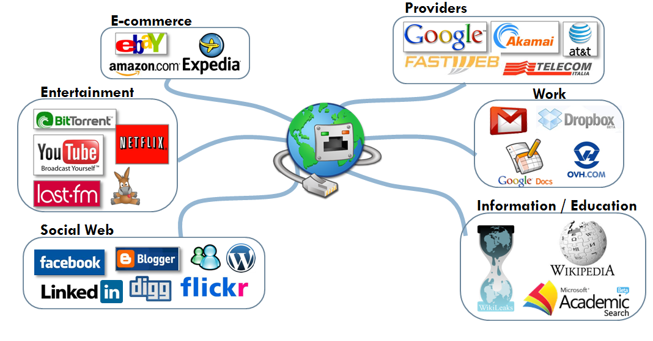

The nowadays Internet
“The Internet is the first thing that humanity has built that humanity doesn't understand, the largest experiment in anarchy that we have ever had.”
Eric Schmidt – ex Google Exec. Chairman

Slide 11


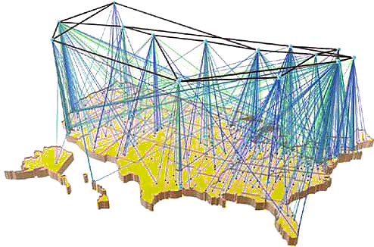

A complicated technology…
Internet: different technologies are combined to offer a plethora of services
We sorely miss the technology to understand what is happening in the network and thus to optimize its performance and utilization
Specially when something goes wrong!

Slide 12




A complicated technology…
…that no one controls and understands
Why is not working?
Which is the best ISP in my area?
Where is traffic coming from?
How to optimize my network for Facebook?
There are no tools to help me !

Slide 13
Why we are here: mPlane motivation
The Internet is a global interconnection of networks
  No single organization operates, administers or governs it
  It is robust thanks to its diversity, but it is vulnerable and fragile
In case of “failure”, who can tell what’s going wrong?
  Each ISP may have a figure of what happens inside its network
  But what if the failure depends on other ISPs? Or on the content provider? Or on the CDN? Or on user equipment?
Today, the web is a tangle
  Nobody really understands what happens today in the Internet
  How to predict what will happen tomorrow?
We need an intelligent system that collects, analyzes, provides visibility to support better management: an oracle that provides answers

Slide 14
How can mPlane solve the problem(s)?

Slide 15
The mPlane vision
Goal: design and demonstration of a measurement plane for the Internet
  A distributed infrastructure for network measurement
  … which perform passive and active measurements, continuously or on-demand, at a wide variety of scales
  … with built-in support for iterative measurement and automated iteration.
mPlane is about
  large scale network measurements,
  and intelligent big-data analysis for troubleshooting support
  embedding measurement into the Internet as an additional capability

Slide 16
mPlane in a slide
Build a distributed, open, standard measurement infrastructure for the Internet
  Probes (WP2) – get the data
    Build on existing tools/methodologies
    Offer a flexible, programmable, open platform to run and collect passive, active, hybrid measurement
  Repositories (WP3) – store and preprocess the data
    Collect measurement in a standard way
    Pre-process large amounts of data in efficient ways
    Grant access to interested parties (ISP, content providers, end-users, regulation agencies, etc.) subject to authorization rules
  Intelligent reasoner (WP4) – dig into the data
    Mine automatically the data and extract useful information
    Help in drilling down to the root cause of a problem
Aprad Bakay
Pietro Michiardi
Pedro Casas

Slide 17
mPlane architecture

Slide 22
mPlane architecture
How to glue everything together?

Slide 23
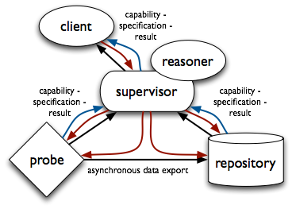
Basic architecture
Probes measure
Repositories collect and analyze
Supervisor controls
Reasoners automates iteration

Slide 24
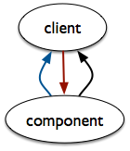
Everything’s a component
  A component implements the mPlane control interfaces:
    advertises its capabilities,
    accepts measurement specifications,
    provides results (or receipts therefor), and
    may participate in brokered asynchronous data export.
  A client uses these interfaces to direct the components to perform a measurement.
  Supervisor = component + client with algorithms for mapping higher-level to lower-level specifications, consolidating results from lower-level components.

Slide 25
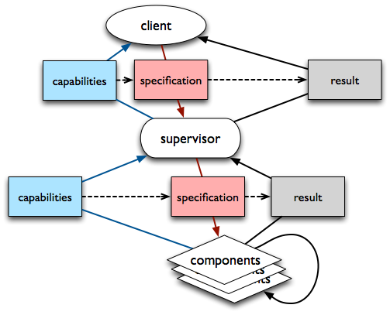
Measurement Workflow

Slide 26
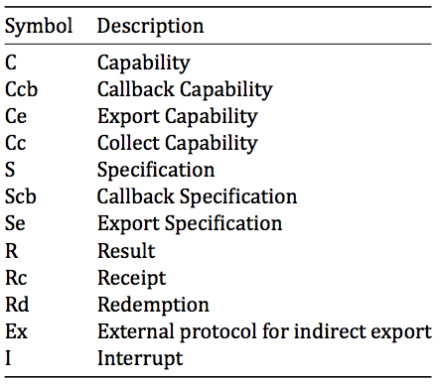
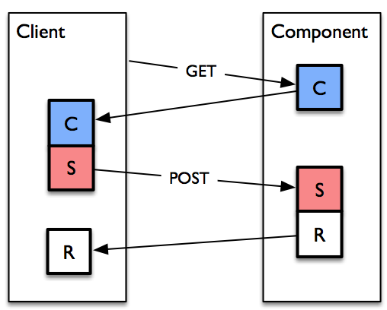
Immediate component-push
Client gets Capabilities direct from Component
Specifications based on Capabilities sent via POST, Results directly in response.
Implemented by httpsrv, client for <5s Jobs.

Slide 27
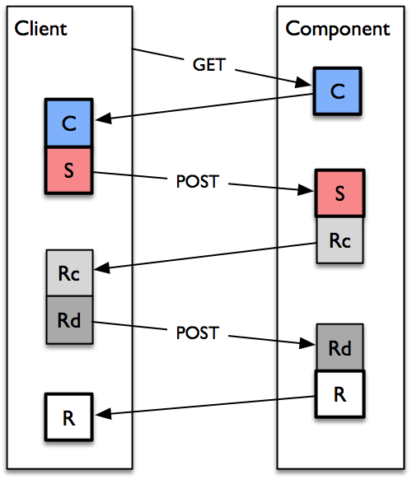
Delayed component-push
Client gets Capabilities direct from Component
Specifications based on Capabilities sent via POST, Receipt in response.
Client polls by POSTing Redemption, Result in response.
Implemented by httpsrv, client for >5s Jobs.

Slide 28
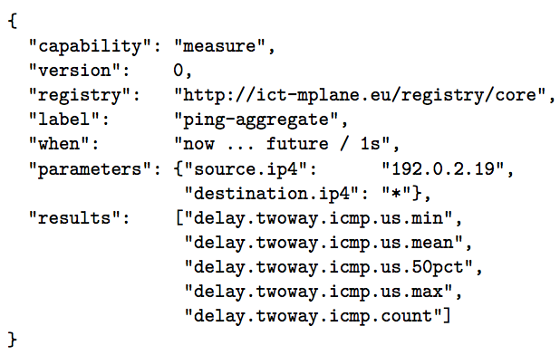
An example: active two-way delay
Capability:
  measure mean two-way-delay (integer milliseconds); given
    source (192.0.2.19/32),
    destination (any in *),
    period (1s - 3600s),
    and interval ([now, +∞), i.e., on-demand)

Slide 29
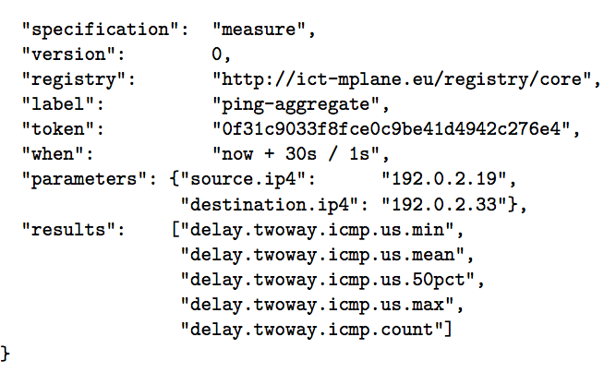
An example: active two-way delay
Specification:
  measure mean two-way-delay; with
    source: 192.0.2.19,
    destination:192.0.2.33,
    period: 1s,
    and interval (now, now+30s].

Slide 30
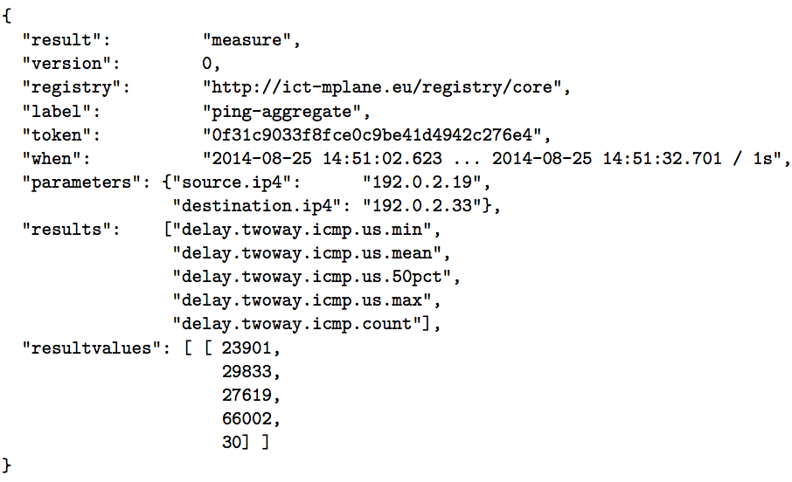
An example: active two-way delay
Result:
  mean two-way-delay was 29.8ms
    from source 192.0.2.19
    to destination 192.0.2.33
    with period 1s
    in interval [2014-08-25 14:51:02.623, 2014-08-25 14:51:32.701]

Slide 31
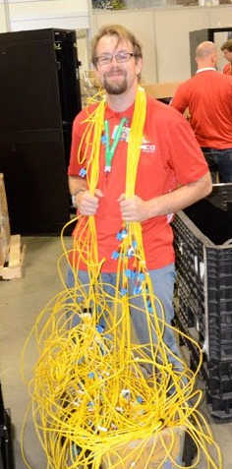
In more details
Brian Trammell
See the glue master talk
after lunch

Slide 33
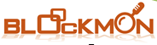





Probes
Passive probes
Active probes
https://www.ict-mplane.eu/public/software
YouTubeProbe
FireLog Project
FastPing
mSLACert
DATI
QoF
MobileProbe

Slide 35

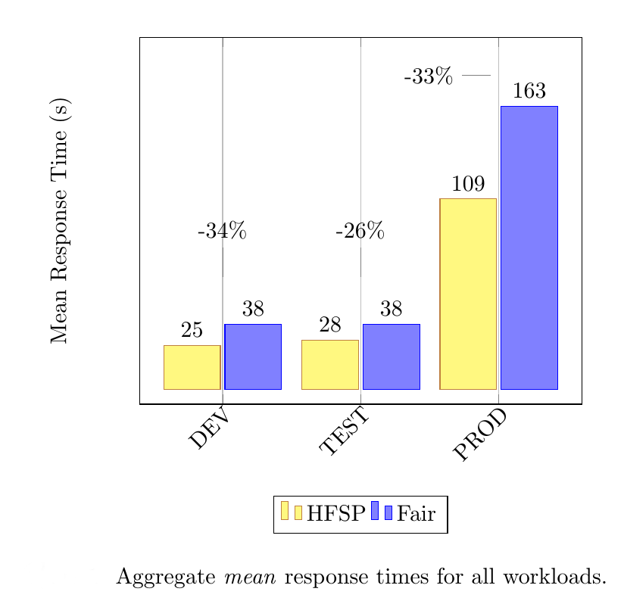
Repositories
DISC
  Import data via Flume, store on HDFS
NAS
  Import Tstat logs with different time granularities
DBStream
  A data stream warehouse
  Process and combine data from multiple sources
BlockMon
  Stream processing
Algorithms
Rule mining on Hadoop
Size-Based
scheduling
ADTool
repoSim

Slide 37
Supervisor and reasoner
The supervisor
Orchestrate components
Provides Access, Authorization functionalities
Offers capabilities to clients
Allows inter-AS communications
The reasoner
Allows semiautomatic processing
Based on events
Follows a decision tree-like approach
  For troubleshooting support
    iteratively find the Root Causes of the associated problems
  For measurement analysis
    automate the iterative process

Slide 38
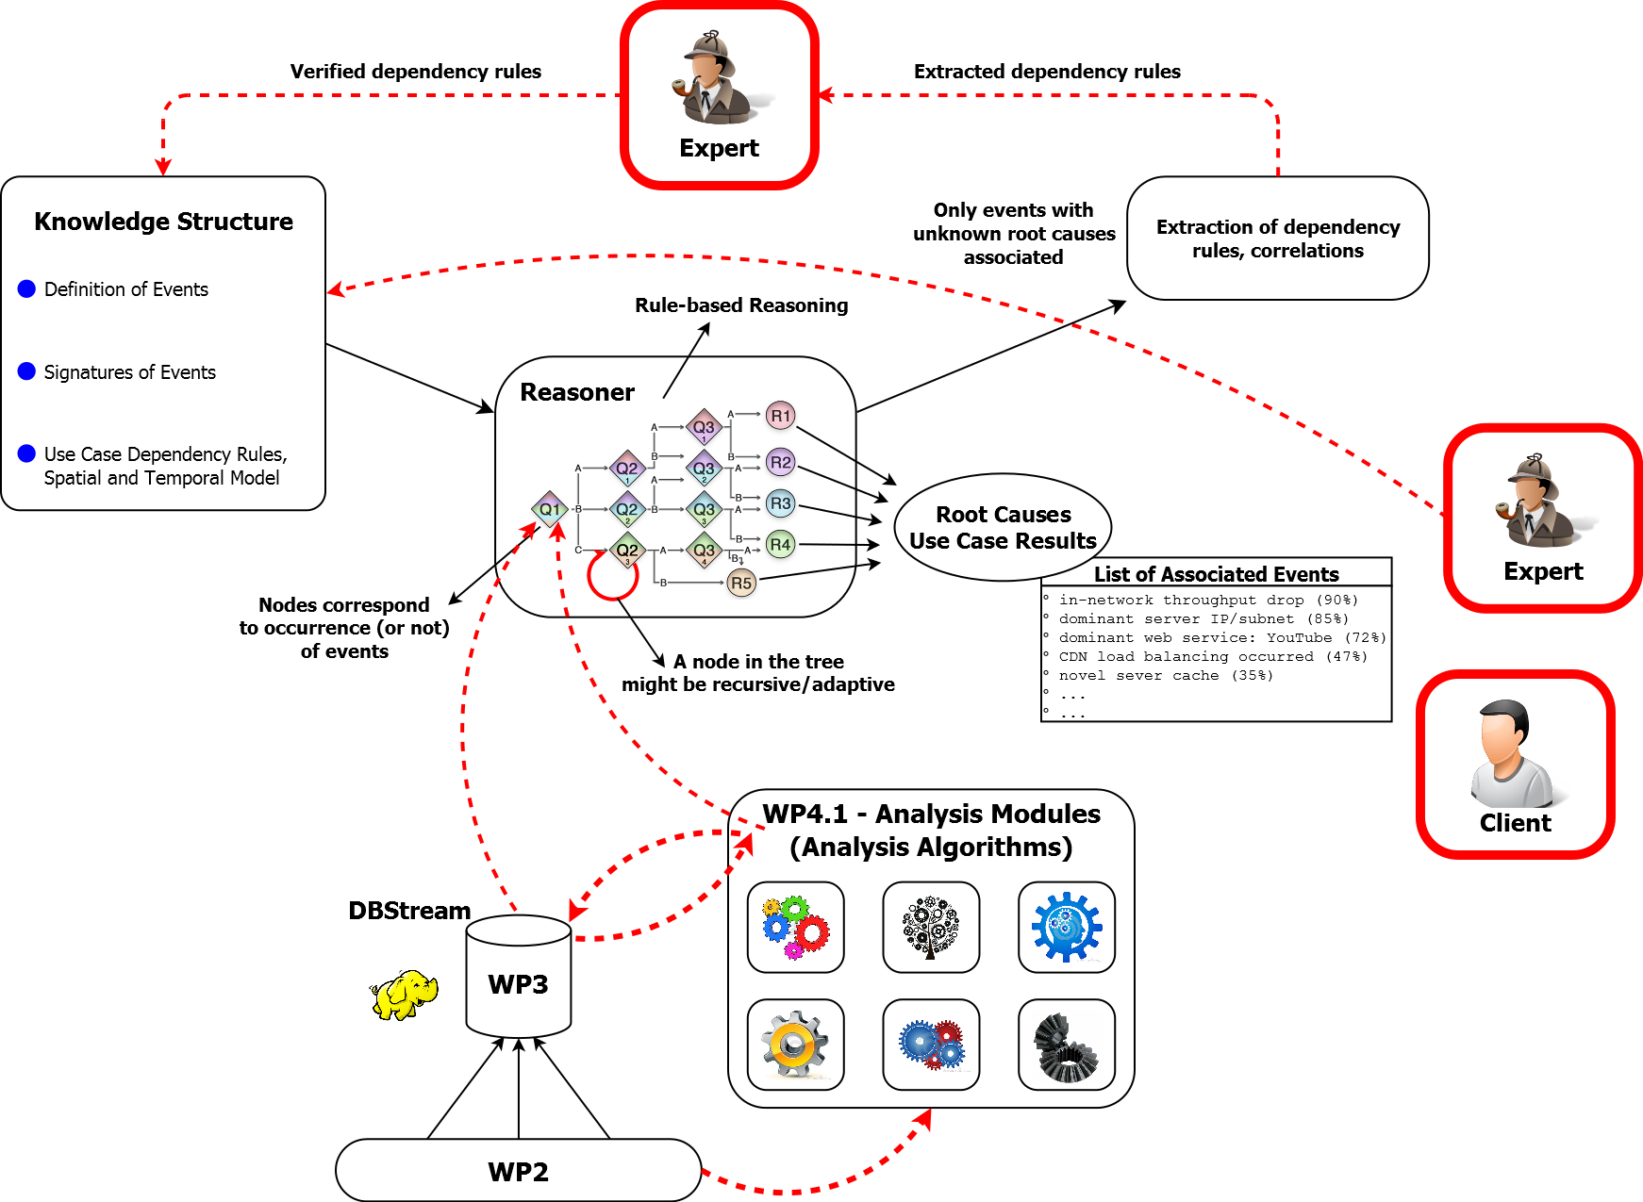
The Reasoner – The Overall Picture
Knowledge Discovery
The “Knowledge” of the Reasoner
Learning
(un)supervised
Reasoning/Diagnosis
Process
Automate Analysis, based on what I know
What I Know

Slide 39
Use cases

Slide 40
Some of the mPlane Use Cases
Cloud services troubleshooting
Mobile network performance issues troubleshooting
Web browsing QoE troubleshooting
Multimedia content delivery troubleshooting
SLA verification and certification
Anomaly detection and diagnosis in large scale networks
Content and service popularity estimation & caching for network optimization
Passive content curation

Slide 41
Cloud services troubleshooting
Scenario: Remote Desktop service
Question: is the network good enough to support the service?
Problem: “good enough” depends on applications
  Text editing != video streaming != gaming
Technology:
  Supervised classifier => which app is the user running?
  QoE estimator from low level QoS parameters

Slide 42
Cloud services troubleshooting

Slide 43
Mobile performance troubleshooting
Scenario: Web browsing from a Smartphone
Question: if the service doesn’t work properly, who to blame?
Problem: The network is a complicated technology that we do not understand…
Technology:
  Supervised classifier => where is the culprit?
  Divide and conquer approach

Slide 44
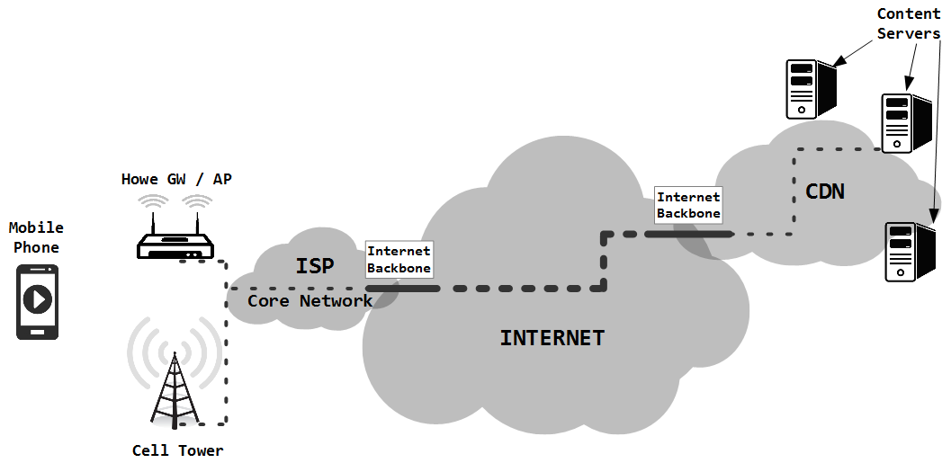
Mobile performance troubleshooting

Slide 45
Some of the mPlane Use Cases
Cloud services troubleshooting
Mobile network performance issues troubleshooting
Web browsing QoE troubleshooting
Multimedia content delivery troubleshooting
SLA verification and certification
Anomaly detection and diagnosis in large scale networks
Content and service popularity estimation & caching for network optimization
Passive content curation

Slide 46
Anomaly detection and diagnosis in large scale networks
Scenario: CDN handle >80% of web traffic
Question: if YouTube doesn’t work properly, who to blame?
Problem: The network is a complicated technology that we do not understand…
Technology:
  Passive monitoring and big data analysis
  Domain knowledge and automatic tools

Slide 47

Something we “watch”
ISPs
 |  | 5-May |  | 6-May |  | 7-May |  | 8-May |  | 9-May |  | 10-May
SUBNET | NAME with AIRPORT code | #flow | Tru avg | #flow | Tru avg | #flow | Tru avg | #flow | Tru avg | #flow | Tru avg | #flow | Tru avg
173.194.18 | fra02s08.c.youtube.com | -1 | -1 | -1 | -1 | -1 | -1 | 6139 | 368.93 | 6266 | 298.4 | 5389 | 228.76
173.194.19 | fra02s15.c.youtube.com | -1 | -1 | -1 | -1 | -1 | -1 | 9940 | 258.18 | 12893 | 196.06 | 7012 | 166.48
173.194.2 | mil01s12.c.youtube.com | 17054 | 1333.46 | 15470 | 1276.31 | 13655 | 1259.63 | 14186 | 1296.07 | 12616 | 1197.64 | 13860 | 1338.63
173.194.20 | par08s06.c.youtube.com | -1 | -1 | -1 | -1 | -1 | -1 | -1 | -1 | -1 | -1 | -1 | -1
173.194.208 | par08s06.c.youtube.com | -1 | -1 | -1 | -1 | -1 | -1 | -1 | -1 | 487 | 414.63 | 71 | 711.54
173.194.5 | lhr14s08.c.youtube.com | 449 | 1819.57 | 283 | 1658.45 | -1 | -1 | 3470 | 937.18 | 4222 | 1025.49 | 6191 | 1166.08
173.194.6 | fra07s13.c.youtube.com | -1 | -1 | -1 | -1 | -1 | -1 | 4924 | 412.17 | 8749 | 331.14 | 7224 | 318.83
173.194.62 | fra07s19.c.youtube.com | -1 | -1 | -1 | -1 | -1 | -1 | 6160 | 325.82 | 6877 | 248.39 | 6108 | 274.55
173.194.9 | par03s06.c.youtube.com | -1 | -1 | -1 | -1 | -1 | -1 | -1 | -1 | 87 | 355.1 | -1 | -1
208.117.236 | par03x04.c.youtube.com | 179 | 164.18 | 4250 | 540.16 | 957 | 496.91 | -1 | -1 | -1 | -1 | -1 | -1
208.117.248 | mia02s11.c.youtube.com | -1 | -1 | 77 | 552 | -1 | -1 | -1 | -1 | -1 | -1 | -1 | -1
208.117.250 | ams09x06.c.youtube.com | 41430 | 679 | 49437 | 656.39 | 57675 | 653.81 | 567 | 906.65 | -1 | -1 | -1 | -1
208.117.252 | dfw06x02.c.youtube.com | -1 | -1 | 51 | 285.63 | -1 | -1 | -1 | -1 | -1 | -1 | -1 | -1
208.117.254 | fra07x03.c.youtube.com | 838 | 667.29 | 2130 | 852.53 | -1 | -1 | 465 | 606.1 | 126 | 1146.87 | 1033 | 1379.76
74.125.105 | lhr22s16.c.youtube.com | 1829 | 1551.78 | 1655 | 1185.94 | 3957 | 942.47 | 3454 | 990.64 | 4116 | 1061.72 | 7657 | 1126.83
74.125.13 | zrh04s03.c.youtube.com | 719 | 1074.15 | 499 | 2264.09 | 82 | 1302.03 | -1 | -1 | -1 | -1 | -1 | -1
74.125.14 | mil02s01.c.youtube.com | 48366 | 1234.82 | 37968 | 1253.01 | 37182 | 1162.85 | 47844 | 1298.45 | 52594 | 1226.85 | 37755 | 1143.37
74.125.216 | bru02t11.c.youtube.com | -1 | -1 | -1 | -1 | -1 | -1 | -1 | -1 | -1 | -1 | -1 | -1
74.125.218 | fra07t13.c.youtube.com | 8697 | 1355.33 | 12579 | 1338.71 | 8560 | 1239 | 11469 | 1256.32 | 11633 | 1292.58 | 10320 | 1276.33
74.125.4 | lhr22s11.c.youtube.com | 1496 | 1846.25 | 2488 | 1034.78 | 4146 | 1363.63 | -1 | -1 | -1 | -1 | -1 | -1
74.125.99 | fra07s03.c.youtube.com | -1 | -1 | -1 | -1 | -1 | -1 | 4221 | 187.84 | 4913 | 189.64 | 2461 | 136.63

Slide 48
Something we observe
 |  | 5-May |  | 6-May |  | 7-May |  | 8-May |  | 9-May |  | 10-May
SUBNET | NAME with AIRPORT code | #flow | Tru avg | #flow | Tru avg | #flow | Tru avg | #flow | Tru avg | #flow | Tru avg | #flow | Tru avg
173.194.18 | fra02s08.c.youtube.com | -1 | -1 | -1 | -1 | -1 | -1 | 6139 | 368.93 | 6266 | 298.4 | 5389 | 228.76
173.194.19 | fra02s15.c.youtube.com | -1 | -1 | -1 | -1 | -1 | -1 | 9940 | 258.18 | 12893 | 196.06 | 7012 | 166.48
173.194.2 | mil01s12.c.youtube.com | 17054 | 1333.46 | 15470 | 1276.31 | 13655 | 1259.63 | 14186 | 1296.07 | 12616 | 1197.64 | 13860 | 1338.63
173.194.20 | par08s06.c.youtube.com | -1 | -1 | -1 | -1 | -1 | -1 | -1 | -1 | -1 | -1 | -1 | -1
173.194.208 | par08s06.c.youtube.com | -1 | -1 | -1 | -1 | -1 | -1 | -1 | -1 | 487 | 414.63 | 71 | 711.54
173.194.5 | lhr14s08.c.youtube.com | 449 | 1819.57 | 283 | 1658.45 | -1 | -1 | 3470 | 937.18 | 4222 | 1025.49 | 6191 | 1166.08
173.194.6 | fra07s13.c.youtube.com | -1 | -1 | -1 | -1 | -1 | -1 | 4924 | 412.17 | 8749 | 331.14 | 7224 | 318.83
173.194.62 | fra07s19.c.youtube.com | -1 | -1 | -1 | -1 | -1 | -1 | 6160 | 325.82 | 6877 | 248.39 | 6108 | 274.55
173.194.9 | par03s06.c.youtube.com | -1 | -1 | -1 | -1 | -1 | -1 | -1 | -1 | 87 | 355.1 | -1 | -1
208.117.236 | par03x04.c.youtube.com | 179 | 164.18 | 4250 | 540.16 | 957 | 496.91 | -1 | -1 | -1 | -1 | -1 | -1
208.117.248 | mia02s11.c.youtube.com | -1 | -1 | 77 | 552 | -1 | -1 | -1 | -1 | -1 | -1 | -1 | -1
208.117.250 | ams09x06.c.youtube.com | 41430 | 679 | 49437 | 656.39 | 57675 | 653.81 | 567 | 906.65 | -1 | -1 | -1 | -1
208.117.252 | dfw06x02.c.youtube.com | -1 | -1 | 51 | 285.63 | -1 | -1 | -1 | -1 | -1 | -1 | -1 | -1
208.117.254 | fra07x03.c.youtube.com | 838 | 667.29 | 2130 | 852.53 | -1 | -1 | 465 | 606.1 | 126 | 1146.87 | 1033 | 1379.76
74.125.105 | lhr22s16.c.youtube.com | 1829 | 1551.78 | 1655 | 1185.94 | 3957 | 942.47 | 3454 | 990.64 | 4116 | 1061.72 | 7657 | 1126.83
74.125.13 | zrh04s03.c.youtube.com | 719 | 1074.15 | 499 | 2264.09 | 82 | 1302.03 | -1 | -1 | -1 | -1 | -1 | -1
74.125.14 | mil02s01.c.youtube.com | 48366 | 1234.82 | 37968 | 1253.01 | 37182 | 1162.85 | 47844 | 1298.45 | 52594 | 1226.85 | 37755 | 1143.37
74.125.216 | bru02t11.c.youtube.com | -1 | -1 | -1 | -1 | -1 | -1 | -1 | -1 | -1 | -1 | -1 | -1
74.125.218 | fra07t13.c.youtube.com | 8697 | 1355.33 | 12579 | 1338.71 | 8560 | 1239 | 11469 | 1256.32 | 11633 | 1292.58 | 10320 | 1276.33
74.125.4 | lhr22s11.c.youtube.com | 1496 | 1846.25 | 2488 | 1034.78 | 4146 | 1363.63 | -1 | -1 | -1 | -1 | -1 | -1
74.125.99 | fra07s03.c.youtube.com | -1 | -1 | -1 | -1 | -1 | -1 | 4221 | 187.84 | 4913 | 189.64 | 2461 | 136.63

Slide 49
Something we observe
 |  | 5-May |  | 6-May |  | 7-May |  | 8-May |  | 9-May |  | 10-May
SUBNET | NAME with AIRPORT code | #flow | Tru avg | #flow | Tru avg | #flow | Tru avg | #flow | Tru avg | #flow | Tru avg | #flow | Tru avg
173.194.18 | fra02s08.c.youtube.com | -1 | -1 | -1 | -1 | -1 | -1 | 6139 | 368.93 | 6266 | 298.4 | 5389 | 228.76
173.194.19 | fra02s15.c.youtube.com | -1 | -1 | -1 | -1 | -1 | -1 | 9940 | 258.18 | 12893 | 196.06 | 7012 | 166.48
173.194.2 | mil01s12.c.youtube.com | 17054 | 1333.46 | 15470 | 1276.31 | 13655 | 1259.63 | 14186 | 1296.07 | 12616 | 1197.64 | 13860 | 1338.63
173.194.20 | par08s06.c.youtube.com | -1 | -1 | -1 | -1 | -1 | -1 | -1 | -1 | -1 | -1 | -1 | -1
173.194.208 | par08s06.c.youtube.com | -1 | -1 | -1 | -1 | -1 | -1 | -1 | -1 | 487 | 414.63 | 71 | 711.54
173.194.5 | lhr14s08.c.youtube.com | 449 | 1819.57 | 283 | 1658.45 | -1 | -1 | 3470 | 937.18 | 4222 | 1025.49 | 6191 | 1166.08
173.194.6 | fra07s13.c.youtube.com | -1 | -1 | -1 | -1 | -1 | -1 | 4924 | 412.17 | 8749 | 331.14 | 7224 | 318.83
173.194.62 | fra07s19.c.youtube.com | -1 | -1 | -1 | -1 | -1 | -1 | 6160 | 325.82 | 6877 | 248.39 | 6108 | 274.55
173.194.9 | par03s06.c.youtube.com | -1 | -1 | -1 | -1 | -1 | -1 | -1 | -1 | 87 | 355.1 | -1 | -1
208.117.236 | par03x04.c.youtube.com | 179 | 164.18 | 4250 | 540.16 | 957 | 496.91 | -1 | -1 | -1 | -1 | -1 | -1
208.117.248 | mia02s11.c.youtube.com | -1 | -1 | 77 | 552 | -1 | -1 | -1 | -1 | -1 | -1 | -1 | -1
208.117.250 | ams09x06.c.youtube.com | 41430 | 679 | 49437 | 656.39 | 57675 | 653.81 | 567 | 906.65 | -1 | -1 | -1 | -1
208.117.252 | dfw06x02.c.youtube.com | -1 | -1 | 51 | 285.63 | -1 | -1 | -1 | -1 | -1 | -1 | -1 | -1
208.117.254 | fra07x03.c.youtube.com | 838 | 667.29 | 2130 | 852.53 | -1 | -1 | 465 | 606.1 | 126 | 1146.87 | 1033 | 1379.76
74.125.105 | lhr22s16.c.youtube.com | 1829 | 1551.78 | 1655 | 1185.94 | 3957 | 942.47 | 3454 | 990.64 | 4116 | 1061.72 | 7657 | 1126.83
74.125.13 | zrh04s03.c.youtube.com | 719 | 1074.15 | 499 | 2264.09 | 82 | 1302.03 | -1 | -1 | -1 | -1 | -1 | -1
74.125.14 | mil02s01.c.youtube.com | 48366 | 1234.82 | 37968 | 1253.01 | 37182 | 1162.85 | 47844 | 1298.45 | 52594 | 1226.85 | 37755 | 1143.37
74.125.216 | bru02t11.c.youtube.com | -1 | -1 | -1 | -1 | -1 | -1 | -1 | -1 | -1 | -1 | -1 | -1
74.125.218 | fra07t13.c.youtube.com | 8697 | 1355.33 | 12579 | 1338.71 | 8560 | 1239 | 11469 | 1256.32 | 11633 | 1292.58 | 10320 | 1276.33
74.125.4 | lhr22s11.c.youtube.com | 1496 | 1846.25 | 2488 | 1034.78 | 4146 | 1363.63 | -1 | -1 | -1 | -1 | -1 | -1
74.125.99 | fra07s03.c.youtube.com | -1 | -1 | -1 | -1 | -1 | -1 | 4221 | 187.84 | 4913 | 189.64 | 2461 | 136.63

Slide 50
Something we observe
 |  | 5-May |  | 6-May |  | 7-May |  | 8-May |  | 9-May |  | 10-May
SUBNET | NAME with AIRPORT code | #flow | Tru avg | #flow | Tru avg | #flow | Tru avg | #flow | Tru avg | #flow | Tru avg | #flow | Tru avg
173.194.18 | fra02s08.c.youtube.com | -1 | -1 | -1 | -1 | -1 | -1 | 6139 | 368.93 | 6266 | 298.4 | 5389 | 228.76
173.194.19 | fra02s15.c.youtube.com | -1 | -1 | -1 | -1 | -1 | -1 | 9940 | 258.18 | 12893 | 196.06 | 7012 | 166.48
173.194.2 | mil01s12.c.youtube.com | 17054 | 1333.46 | 15470 | 1276.31 | 13655 | 1259.63 | 14186 | 1296.07 | 12616 | 1197.64 | 13860 | 1338.63
173.194.20 | par08s06.c.youtube.com | -1 | -1 | -1 | -1 | -1 | -1 | -1 | -1 | -1 | -1 | -1 | -1
173.194.208 | par08s06.c.youtube.com | -1 | -1 | -1 | -1 | -1 | -1 | -1 | -1 | 487 | 414.63 | 71 | 711.54
173.194.5 | lhr14s08.c.youtube.com | 449 | 1819.57 | 283 | 1658.45 | -1 | -1 | 3470 | 937.18 | 4222 | 1025.49 | 6191 | 1166.08
173.194.6 | fra07s13.c.youtube.com | -1 | -1 | -1 | -1 | -1 | -1 | 4924 | 412.17 | 8749 | 331.14 | 7224 | 318.83
173.194.62 | fra07s19.c.youtube.com | -1 | -1 | -1 | -1 | -1 | -1 | 6160 | 325.82 | 6877 | 248.39 | 6108 | 274.55
173.194.9 | par03s06.c.youtube.com | -1 | -1 | -1 | -1 | -1 | -1 | -1 | -1 | 87 | 355.1 | -1 | -1
208.117.236 | par03x04.c.youtube.com | 179 | 164.18 | 4250 | 540.16 | 957 | 496.91 | -1 | -1 | -1 | -1 | -1 | -1
208.117.248 | mia02s11.c.youtube.com | -1 | -1 | 77 | 552 | -1 | -1 | -1 | -1 | -1 | -1 | -1 | -1
208.117.250 | ams09x06.c.youtube.com | 41430 | 679 | 49437 | 656.39 | 57675 | 653.81 | 567 | 906.65 | -1 | -1 | -1 | -1
208.117.252 | dfw06x02.c.youtube.com | -1 | -1 | 51 | 285.63 | -1 | -1 | -1 | -1 | -1 | -1 | -1 | -1
208.117.254 | fra07x03.c.youtube.com | 838 | 667.29 | 2130 | 852.53 | -1 | -1 | 465 | 606.1 | 126 | 1146.87 | 1033 | 1379.76
74.125.105 | lhr22s16.c.youtube.com | 1829 | 1551.78 | 1655 | 1185.94 | 3957 | 942.47 | 3454 | 990.64 | 4116 | 1061.72 | 7657 | 1126.83
74.125.13 | zrh04s03.c.youtube.com | 719 | 1074.15 | 499 | 2264.09 | 82 | 1302.03 | -1 | -1 | -1 | -1 | -1 | -1
74.125.14 | mil02s01.c.youtube.com | 48366 | 1234.82 | 37968 | 1253.01 | 37182 | 1162.85 | 47844 | 1298.45 | 52594 | 1226.85 | 37755 | 1143.37
74.125.216 | bru02t11.c.youtube.com | -1 | -1 | -1 | -1 | -1 | -1 | -1 | -1 | -1 | -1 | -1 | -1
74.125.218 | fra07t13.c.youtube.com | 8697 | 1355.33 | 12579 | 1338.71 | 8560 | 1239 | 11469 | 1256.32 | 11633 | 1292.58 | 10320 | 1276.33
74.125.4 | lhr22s11.c.youtube.com | 1496 | 1846.25 | 2488 | 1034.78 | 4146 | 1363.63 | -1 | -1 | -1 | -1 | -1 | -1
74.125.99 | fra07s03.c.youtube.com | -1 | -1 | -1 | -1 | -1 | -1 | 4221 | 187.84 | 4913 | 189.64 | 2461 | 136.63

Slide 51
Something we observe
 |  | 5-May |  | 6-May |  | 7-May |  | 8-May |  | 9-May |  | 10-May
SUBNET | NAME with AIRPORT code | #flow | Tru avg | #flow | Tru avg | #flow | Tru avg | #flow | Tru avg | #flow | Tru avg | #flow | Tru avg
173.194.18 | fra02s08.c.youtube.com | -1 | -1 | -1 | -1 | -1 | -1 | 6139 | 368.93 | 6266 | 298.4 | 5389 | 228.76
173.194.19 | fra02s15.c.youtube.com | -1 | -1 | -1 | -1 | -1 | -1 | 9940 | 258.18 | 12893 | 196.06 | 7012 | 166.48
173.194.2 | mil01s12.c.youtube.com | 17054 | 1333.46 | 15470 | 1276.31 | 13655 | 1259.63 | 14186 | 1296.07 | 12616 | 1197.64 | 13860 | 1338.63
173.194.20 | par08s06.c.youtube.com | -1 | -1 | -1 | -1 | -1 | -1 | -1 | -1 | -1 | -1 | -1 | -1
173.194.208 | par08s06.c.youtube.com | -1 | -1 | -1 | -1 | -1 | -1 | -1 | -1 | 487 | 414.63 | 71 | 711.54
173.194.5 | lhr14s08.c.youtube.com | 449 | 1819.57 | 283 | 1658.45 | -1 | -1 | 3470 | 937.18 | 4222 | 1025.49 | 6191 | 1166.08
173.194.6 | fra07s13.c.youtube.com | -1 | -1 | -1 | -1 | -1 | -1 | 4924 | 412.17 | 8749 | 331.14 | 7224 | 318.83
173.194.62 | fra07s19.c.youtube.com | -1 | -1 | -1 | -1 | -1 | -1 | 6160 | 325.82 | 6877 | 248.39 | 6108 | 274.55
173.194.9 | par03s06.c.youtube.com | -1 | -1 | -1 | -1 | -1 | -1 | -1 | -1 | 87 | 355.1 | -1 | -1
208.117.236 | par03x04.c.youtube.com | 179 | 164.18 | 4250 | 540.16 | 957 | 496.91 | -1 | -1 | -1 | -1 | -1 | -1
208.117.248 | mia02s11.c.youtube.com | -1 | -1 | 77 | 552 | -1 | -1 | -1 | -1 | -1 | -1 | -1 | -1
208.117.250 | ams09x06.c.youtube.com | 41430 | 679 | 49437 | 656.39 | 57675 | 653.81 | 567 | 906.65 | -1 | -1 | -1 | -1
208.117.252 | dfw06x02.c.youtube.com | -1 | -1 | 51 | 285.63 | -1 | -1 | -1 | -1 | -1 | -1 | -1 | -1
208.117.254 | fra07x03.c.youtube.com | 838 | 667.29 | 2130 | 852.53 | -1 | -1 | 465 | 606.1 | 126 | 1146.87 | 1033 | 1379.76
74.125.105 | lhr22s16.c.youtube.com | 1829 | 1551.78 | 1655 | 1185.94 | 3957 | 942.47 | 3454 | 990.64 | 4116 | 1061.72 | 7657 | 1126.83
74.125.13 | zrh04s03.c.youtube.com | 719 | 1074.15 | 499 | 2264.09 | 82 | 1302.03 | -1 | -1 | -1 | -1 | -1 | -1
74.125.14 | mil02s01.c.youtube.com | 48366 | 1234.82 | 37968 | 1253.01 | 37182 | 1162.85 | 47844 | 1298.45 | 52594 | 1226.85 | 37755 | 1143.37
74.125.216 | bru02t11.c.youtube.com | -1 | -1 | -1 | -1 | -1 | -1 | -1 | -1 | -1 | -1 | -1 | -1
74.125.218 | fra07t13.c.youtube.com | 8697 | 1355.33 | 12579 | 1338.71 | 8560 | 1239 | 11469 | 1256.32 | 11633 | 1292.58 | 10320 | 1276.33
74.125.4 | lhr22s11.c.youtube.com | 1496 | 1846.25 | 2488 | 1034.78 | 4146 | 1363.63 | -1 | -1 | -1 | -1 | -1 | -1
74.125.99 | fra07s03.c.youtube.com | -1 | -1 | -1 | -1 | -1 | -1 | 4221 | 187.84 | 4913 | 189.64 | 2461 | 136.63

Slide 52
Something we observe
 |  | 5-May |  | 6-May |  | 7-May |  | 8-May |  | 9-May |  | 10-May
SUBNET | NAME with AIRPORT code | #flow | Tru avg | #flow | Tru avg | #flow | Tru avg | #flow | Tru avg | #flow | Tru avg | #flow | Tru avg
173.194.18 | fra02s08.c.youtube.com | -1 | -1 | -1 | -1 | -1 | -1 | 6139 | 368.93 | 6266 | 298.4 | 5389 | 228.76
173.194.19 | fra02s15.c.youtube.com | -1 | -1 | -1 | -1 | -1 | -1 | 9940 | 258.18 | 12893 | 196.06 | 7012 | 166.48
173.194.2 | mil01s12.c.youtube.com | 17054 | 1333.46 | 15470 | 1276.31 | 13655 | 1259.63 | 14186 | 1296.07 | 12616 | 1197.64 | 13860 | 1338.63
173.194.20 | par08s06.c.youtube.com | -1 | -1 | -1 | -1 | -1 | -1 | -1 | -1 | -1 | -1 | -1 | -1
173.194.208 | par08s06.c.youtube.com | -1 | -1 | -1 | -1 | -1 | -1 | -1 | -1 | 487 | 414.63 | 71 | 711.54
173.194.5 | lhr14s08.c.youtube.com | 449 | 1819.57 | 283 | 1658.45 | -1 | -1 | 3470 | 937.18 | 4222 | 1025.49 | 6191 | 1166.08
173.194.6 | fra07s13.c.youtube.com | -1 | -1 | -1 | -1 | -1 | -1 | 4924 | 412.17 | 8749 | 331.14 | 7224 | 318.83
173.194.62 | fra07s19.c.youtube.com | -1 | -1 | -1 | -1 | -1 | -1 | 6160 | 325.82 | 6877 | 248.39 | 6108 | 274.55
173.194.9 | par03s06.c.youtube.com | -1 | -1 | -1 | -1 | -1 | -1 | -1 | -1 | 87 | 355.1 | -1 | -1
208.117.236 | par03x04.c.youtube.com | 179 | 164.18 | 4250 | 540.16 | 957 | 496.91 | -1 | -1 | -1 | -1 | -1 | -1
208.117.248 | mia02s11.c.youtube.com | -1 | -1 | 77 | 552 | -1 | -1 | -1 | -1 | -1 | -1 | -1 | -1
208.117.250 | ams09x06.c.youtube.com | 41430 | 679 | 49437 | 656.39 | 57675 | 653.81 | 567 | 906.65 | -1 | -1 | -1 | -1
208.117.252 | dfw06x02.c.youtube.com | -1 | -1 | 51 | 285.63 | -1 | -1 | -1 | -1 | -1 | -1 | -1 | -1
208.117.254 | fra07x03.c.youtube.com | 838 | 667.29 | 2130 | 852.53 | -1 | -1 | 465 | 606.1 | 126 | 1146.87 | 1033 | 1379.76
74.125.105 | lhr22s16.c.youtube.com | 1829 | 1551.78 | 1655 | 1185.94 | 3957 | 942.47 | 3454 | 990.64 | 4116 | 1061.72 | 7657 | 1126.83
74.125.13 | zrh04s03.c.youtube.com | 719 | 1074.15 | 499 | 2264.09 | 82 | 1302.03 | -1 | -1 | -1 | -1 | -1 | -1
74.125.14 | mil02s01.c.youtube.com | 48366 | 1234.82 | 37968 | 1253.01 | 37182 | 1162.85 | 47844 | 1298.45 | 52594 | 1226.85 | 37755 | 1143.37
74.125.216 | bru02t11.c.youtube.com | -1 | -1 | -1 | -1 | -1 | -1 | -1 | -1 | -1 | -1 | -1 | -1
74.125.218 | fra07t13.c.youtube.com | 8697 | 1355.33 | 12579 | 1338.71 | 8560 | 1239 | 11469 | 1256.32 | 11633 | 1292.58 | 10320 | 1276.33
74.125.4 | lhr22s11.c.youtube.com | 1496 | 1846.25 | 2488 | 1034.78 | 4146 | 1363.63 | -1 | -1 | -1 | -1 | -1 | -1
74.125.99 | fra07s03.c.youtube.com | -1 | -1 | -1 | -1 | -1 | -1 | 4221 | 187.84 | 4913 | 189.64 | 2461 | 136.63

Slide 53

Something we observe
 |  | 5-May |  | 6-May |  | 7-May |  | 8-May |  | 9-May |  | 10-May
SUBNET | NAME with AIRPORT code | #flow | Tru avg | #flow | Tru avg | #flow | Tru avg | #flow | Tru avg | #flow | Tru avg | #flow | Tru avg
173.194.18 | fra02s08.c.youtube.com | -1 | -1 | -1 | -1 | -1 | -1 | 6139 | 368.93 | 6266 | 298.4 | 5389 | 228.76
173.194.19 | fra02s15.c.youtube.com | -1 | -1 | -1 | -1 | -1 | -1 | 9940 | 258.18 | 12893 | 196.06 | 7012 | 166.48
173.194.2 | mil01s12.c.youtube.com | 17054 | 1333.46 | 15470 | 1276.31 | 13655 | 1259.63 | 14186 | 1296.07 | 12616 | 1197.64 | 13860 | 1338.63
173.194.20 | par08s06.c.youtube.com | -1 | -1 | -1 | -1 | -1 | -1 | -1 | -1 | -1 | -1 | -1 | -1
173.194.208 | par08s06.c.youtube.com | -1 | -1 | -1 | -1 | -1 | -1 | -1 | -1 | 487 | 414.63 | 71 | 711.54
173.194.5 | lhr14s08.c.youtube.com | 449 | 1819.57 | 283 | 1658.45 | -1 | -1 | 3470 | 937.18 | 4222 | 1025.49 | 6191 | 1166.08
173.194.6 | fra07s13.c.youtube.com | -1 | -1 | -1 | -1 | -1 | -1 | 4924 | 412.17 | 8749 | 331.14 | 7224 | 318.83
173.194.62 | fra07s19.c.youtube.com | -1 | -1 | -1 | -1 | -1 | -1 | 6160 | 325.82 | 6877 | 248.39 | 6108 | 274.55
173.194.9 | par03s06.c.youtube.com | -1 | -1 | -1 | -1 | -1 | -1 | -1 | -1 | 87 | 355.1 | -1 | -1
208.117.236 | par03x04.c.youtube.com | 179 | 164.18 | 4250 | 540.16 | 957 | 496.91 | -1 | -1 | -1 | -1 | -1 | -1
208.117.248 | mia02s11.c.youtube.com | -1 | -1 | 77 | 552 | -1 | -1 | -1 | -1 | -1 | -1 | -1 | -1
208.117.250 | ams09x06.c.youtube.com | 41430 | 679 | 49437 | 656.39 | 57675 | 653.81 | 567 | 906.65 | -1 | -1 | -1 | -1
208.117.252 | dfw06x02.c.youtube.com | -1 | -1 | 51 | 285.63 | -1 | -1 | -1 | -1 | -1 | -1 | -1 | -1
208.117.254 | fra07x03.c.youtube.com | 838 | 667.29 | 2130 | 852.53 | -1 | -1 | 465 | 606.1 | 126 | 1146.87 | 1033 | 1379.76
74.125.105 | lhr22s16.c.youtube.com | 1829 | 1551.78 | 1655 | 1185.94 | 3957 | 942.47 | 3454 | 990.64 | 4116 | 1061.72 | 7657 | 1126.83
74.125.13 | zrh04s03.c.youtube.com | 719 | 1074.15 | 499 | 2264.09 | 82 | 1302.03 | -1 | -1 | -1 | -1 | -1 | -1
74.125.14 | mil02s01.c.youtube.com | 48366 | 1234.82 | 37968 | 1253.01 | 37182 | 1162.85 | 47844 | 1298.45 | 52594 | 1226.85 | 37755 | 1143.37
74.125.216 | bru02t11.c.youtube.com | -1 | -1 | -1 | -1 | -1 | -1 | -1 | -1 | -1 | -1 | -1 | -1
74.125.218 | fra07t13.c.youtube.com | 8697 | 1355.33 | 12579 | 1338.71 | 8560 | 1239 | 11469 | 1256.32 | 11633 | 1292.58 | 10320 | 1276.33
74.125.4 | lhr22s11.c.youtube.com | 1496 | 1846.25 | 2488 | 1034.78 | 4146 | 1363.63 | -1 | -1 | -1 | -1 | -1 | -1
74.125.99 | fra07s03.c.youtube.com | -1 | -1 | -1 | -1 | -1 | -1 | 4221 | 187.84 | 4913 | 189.64 | 2461 | 136.63

Slide 54
Reasoning about the problem
How to investigate this kind of events?
  You need a flexible, scalable, intelligent supervisor and repository
DBStream:
  Continuous big data analytics
  Flexible processing language
  Full SQL processing capabilities
  Processing in small batches
  Storage for post-mortem analysis
  ADTool to automatically identify anomalies

Slide 55









Who to blame when YouTube doesn’t work OK?
G-CDN
ISP Network
AS 1
AS 2
Devices?
ISP?
Internet?
YouTube?

Slide 56
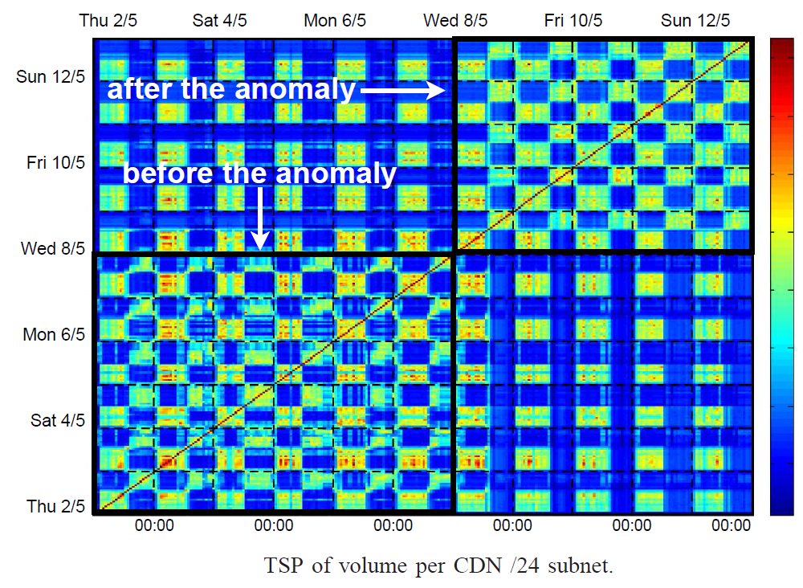
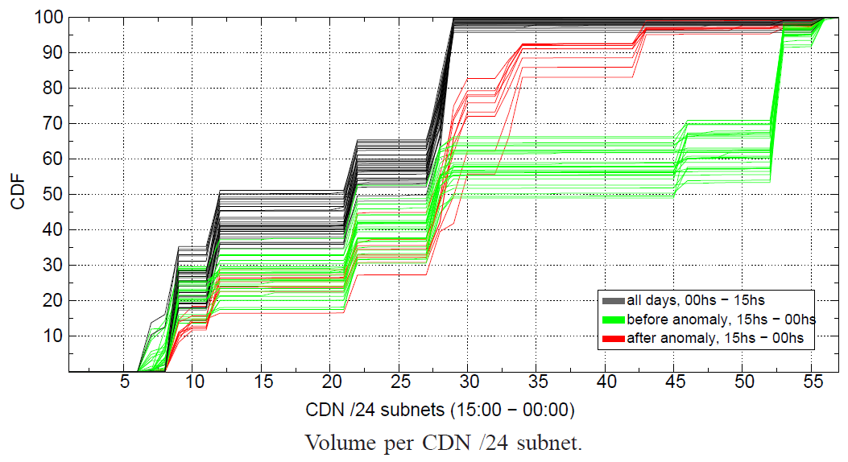

Diagnosis #1 change in the cache-selection policy?
YES!
Temporal Similarity Plot (TSP)
Traffic distribution across /24 subnets
For every time-bin: compute distribution of volume across all /24 Google CDN subnets
Distribution compared with custom Kullback-Leibler metric
Comparisons results plotted on heatmap
Conclusion
A different server selection policy is deployed exactly on the same day when the anomaly starts occurring!

Slide 57
Diagnosis #2
given that change... who is to blame: new servers or path?
Diagnosis #3
is there a correlation between increased RTT and throughput?
The origin of the anomaly is the cache selection done by Google
NO
Diagnosis #4
....
YES/NO
Conclusion

Slide 58
Some of the mPlane Use Cases
Cloud services troubleshooting
Mobile network performance issues troubleshooting
Web browsing QoE troubleshooting
Multimedia content delivery troubleshooting
SLA verification and certification
Anomaly detection and diagnosis in large scale networks
Content and service popularity estimation & caching for network optimization
Passive content curation

Slide 59
Passive content curation
Scenario: Passive measurements
Question: Which content could be useful to promote for end users?
Problem: How to extract from the stream of URLs the interested one that user-clicked
Technology:
  Passive monitoring and big data analysis
  Stream analysis from Gb/s to few URLs to promote

Slide 60

Passive content curation
Live demo!!!

Slide 61
