Slide 1
Cooperative inter-operator traffic measurement frameworks: technical challenges and barriers for industrial adoption
Maurizio Molina, Talaia Solutions
mmolina@talaiasolutions.com
www.talaiasolutions.com
mPlane industrial workshop, Barcelona 22nd April 2015

Slide 2










Challenges? What challenges?
Technical challenges
  Are we done?
The adoption challenges - a.k.a. : got Friends? Foes?
  Are we done?
The “go-to-market” challenges - a.k.a.: problems to solve (better) than existing solutions
  Are we done?
  Yes, hopefully yes….

Slide 3
The technical challenges

Slide 4
OTT vs. Telco? Who pays the bill?
It’ an economic problem rather than a technical one:
  If “winner” is OTT, it’s the users not getting the content
    Content delivered only where NW is good enough => Typical “Digital Divide” issue
  If “winner” is Telco, it’s the users not getting the content
    More limited content choice
Looks the “looser” is always the end user!
The problem is recognised (not necessarily solved…) and “Operator CDN” management systems were developed. They advocate a “Wholesale CDN” scenario” (*).
  Content popularity, content replacement, dynamic CDN leasing
(*) http://www.broadpeak.tv/upload/produit/fichier/18-337-broadpeak_operatorcdn_whitepaper.pdf

Slide 5
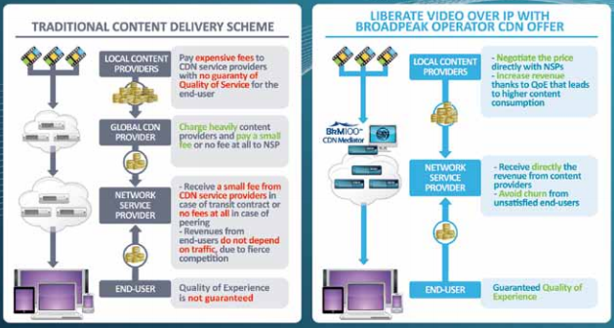
OTT vs. Telco? Who pays the bill?
(*)
Somebody like Netflix probably not liking this picture?
Netflix: “openconnect” initiative (**)
(*) http://www.broadpeak.tv/upload/produit/fichier/18-337-broadpeak_operatorcdn_whitepaper.pdf
(**) netflix.com/openconnect

Slide 6
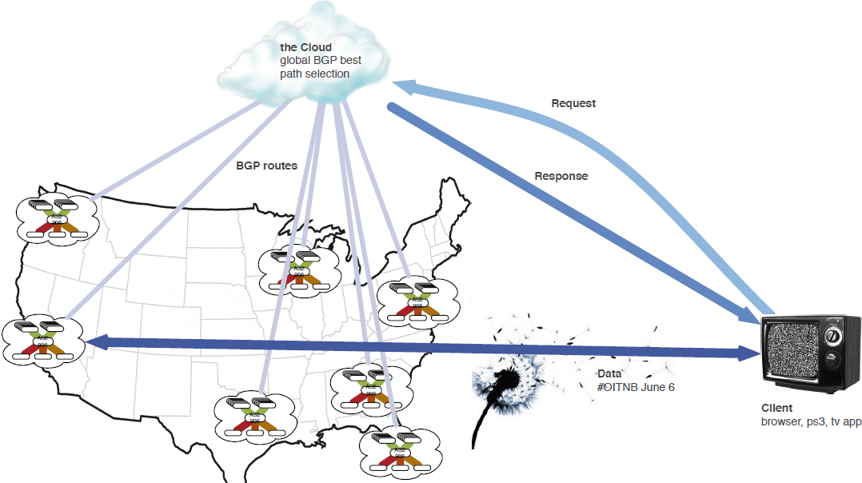
Netflix uses pmacct for traffic monitoring
Based only on NANOG 61 presentation and video (*)
“Many POPs, No Backbone”
“Geography, policy, cost and health used to route viewing sessions”
(*) https://www.youtube.com/watch?v=4VnwwkZG1n8
(*) http://www.pmacct.net/nanog61-pmacct-add-path.pdf

Slide 7
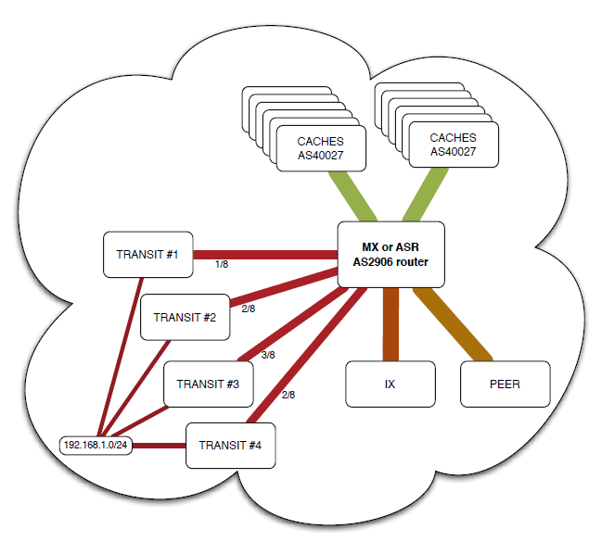
Netflix uses pmacct for traffic monitoring
Based on NANOG 61 presentation and video (*)
“In many cases, too much traffic for 1,2 or even 4 egress partners to handle”
Use of multi_path BGP
Pmacct used as monitoring tool
  Extended to support BGP multi-path
  BGP next hop in NetFlow found to be reliable enough to map flow record to correct path
Ok for accounting, but what about performances?
(*) https://www.youtube.com/watch?v=4VnwwkZG1n8
(*) http://www.pmacct.net/nanog61-pmacct-add-path.pdf

Slide 8
Netflix scenario questions
Q: could the mPlane toolset add performance monitoring in the “NANOG 61 Netflix scenario”?
  Q: what is needed to automate the routing / load balancing choices on the basis of these measurements?
Q: what is needed to let all parties (content provider, “transit partners”, non-transit partners) benefit from mPlane enabled measurements?
  Q: would this be a truly win-win situation, different from existing ones?

Slide 9
MPLS vs IPSEC VPNs
Both MPLS and IPSEC are used to provide site-to-site VPNs
  Encrypted traffic, put back in the clear at the corporate endpoints
However, only MPLS provides mechanisms to really guarantee minimum bandwidth and maximum latency
  Essentially through RSVP-TE
Traditionally, MPLS was the only way to go to implement VPNs supporting voice, video or business critical application
  And very expensive!
Nowadays, IPSEC “on plain Internet” is a much cheaper VPN alternative, and in many parts of the world seems to work well
So, the debate is open…(*)
(*) http://packetlife.net/blog/2014/jul/14/replacing-mpls-wan-internet-vpn-overlay/

Slide 10
MPLS vs IPSEC VPNs – some statements - from the point of view of who is responsible for the service (*)
Go for MPLS: don’t risk your a… when there is a management videoconference!
MPLS is overpriced and may work just as bad as IPSEC (especially in Africa)
Go for IPSEC avoid cable, DSL or anything not T1
Hybrid approach (per location or per application)
Use “half tunnels”: IPSEC until operator’s backbone MPLS Core
(*) http://packetlife.net/blog/2014/jul/14/replacing-mpls-wan-internet-vpn-overlay/

Slide 11
And eventually some words of wisdom… (*)
Thanks Jeff!
“Good monitoring will make a huge difference. Find something that will watch packet loss performance, one way latency, etc. PerfSonar is OSS and geared toward high performance research networks. AppNeta is a slicker solution, and also much more expensive. There's likely other solutions out there, but 5 pings every minute aren't going to do the trick. Issues live in the seconds when your polling monitor isn't running”
Jeff
(*) http://packetlife.net/blog/2014/jul/14/replacing-mpls-wan-internet-vpn-overlay/

Slide 12
MPLS vs IPSEC VPNs scenario questions
Q: Could the mPlane toolset help in moving away from the “war of religion” IPSEC vs MPLs or from the (time consuming) “trial and error” approach?
Q: In other words, can it help achieving a dynamic VPN traffic control mechanism? What is needed to couple it with mechanisms to re-route traffic in real time to better performing “pipes” (e.g. another ISP, or from IPSEC to MPLS VPN)?

Slide 13


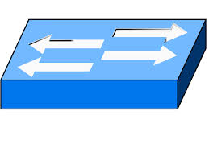
Monitoring in SDN Networks (*)
OpenFlow Controller is fully aware of Network Topology under its administrative control
  also of IP Natting and MAC addresses at endpoints
  Potentially good for flow de-duplication, which is a nasty task!
Bytes and packet counters associated to every OpenFlow entry in OF switches
  OF controller can read these stats on switches asynchronously
  final summary is sent to controller upon OF entry removal
OpenFlow controller
- OF forwarding entries installation, removal
- OF forwarding entries statistics
OpenFlow switch
OpenFlow switch
OpenFlow switch
(*) some inputs coming from publicly available material on http://blog.ipspace.net/

Slide 14
Monitoring in SDN Networks (*)
No pre-defined measurement granularity like SNMP counters or “old” NetFlow(v5).
Approach: install “coarse granularity forwarding entries”, dynamically increase granularity if needed.
This is not completely new: template-based NetFlow v9 or IPFIX are similar
What changes is that this measurement functionality is “embedded in the OF protocol” and a separate protocol like NetFlow is not needed
  Some vendors however guarantee they can support legacy NetFlow Collectors
Easier to implement actions (packet sampling, flow blackholing, redirection to scrubbing devices)
OpenFlow controller
- OF forwarding entries installation, removal
- OF forwarding entries statistics
OpenFlow switch
OpenFlow switch
OpenFlow switch
(*) some inputs coming from publicly available material on http://blog.ipspace.net/

Slide 15
SDN Monitoring questions
  All in all I don’t see a dramatic scenario change wrt existing Network Monitoring capabilities
Q: different views on this?
Q: if OF controller ⬄ mPlane supervisor: how can administratively separate OF controllers exchange information?

Slide 16
The adoption challenges

Slide 17
The “adoption” challenge
Inter-domain collaborative Network Measurement frameworks are not a new idea…
  Intermon (EU Prj) – 2002/2003
    Main benefit was to create a community, I think…
  RIPE Atlas – 2010/now
    Do not know it in detail. Focus on active measurements
  PerfSONAR – 2004/now
    A successful example

Slide 18
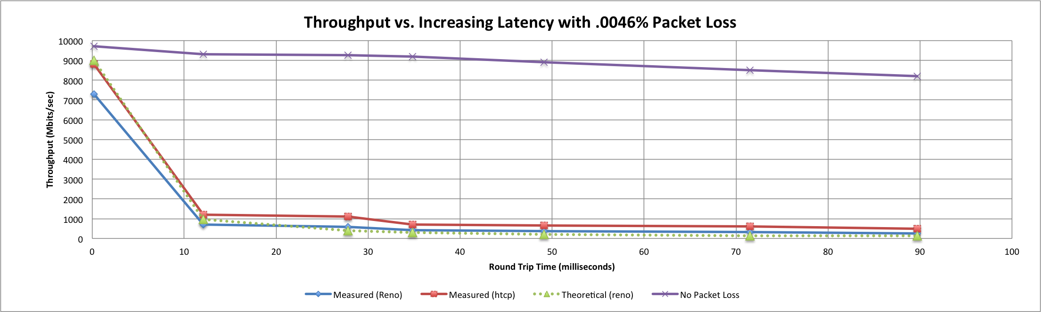
PerfSONAR
Started 2004 (I2, GEANT, Esnet), ~1,200 Toolkit Deployments to date
Key success factors (IMO)
  Pragmatic approach: simple measurements (link utilization) immediately made available
  Precise focus: bulk data transfers “Under-buffered Switches are probably our biggest problem today…” (*)
Local
(LAN)
With loss, high performance beyond metro distances is essentially impossible!
Metro Area
Regional
Continental
International
(*) http://www.perfsonar.net/media/cms_page_media/3088/20150128-perfSONAR-1-Intro_and_Motivation-v2.pptx

Slide 19
Main Challenge
Not the measurements, but the AAI (*) to pilot experiments and access results in a Multi Domain Environment!
  Checking whether the user is authenticated
  Checking whether the user is allowed to do an action in a service
  Checking user’s attributes
Slow progress, although NRENs had an AAI federation…
  Original Web Services (SOAP) model substituted in 2014 with REST model
(*) AAI – Authentication and Authorization Infrastructure

Slide 20
PerfSONAR – difficult to extend?
Born for a particular community (Research Networks)
  “Some” mutual trust and shared AAI tools
  Focus on a very specific (single) problem: supporting huge bulk data transfers around the globe for scientists (“support TCP”)
But killer application for Internet usage now it’s video!
For “commercial VPNs”, there is the need of per application differentiated QoS support!

Slide 21
mPlane: Overcoming PerfSONAR limits?
Q: is there enough focus on per application performance?
  Measuring the “pipe” is not enough for the “commercial internet”
Q: is it clear to mPlane if/what needs to be promoted in standards or elsewhere for widespread adoption?
  Widespread: ≠ “collaborative” NREN & academic community…

Slide 22
Could e.g. this be a good IETF WG proposal?
Various types of measurement data need to be collected to support
monitoring applications….:
(i) aggregate information ….(e.g. SNMP, flows, routing tables) ;
(ii) packet-level traces...
There are a number of implementation challenges in order to capture,
process, summarize and export data at the required level of granularity
at the time that it is needed. Some of these problems are being
addressed in different IETF working groups whereas some others have
not been.
The goal ….
- define a framework for monitoring needed to support day-to-day operations in IP networks
- identify existing and on-going efforts in the IETF on various aspects of
the framework and ensure that this work guarantees inter-operability
among ISPs
- provide clear guidelines to equipment vendors on what infrastructure is needed to support monitoring in ISP networks.

Slide 23
Could e.g. this be a good IETF WG proposal?
A charter for the new working group could address (but not be limited to)
the following aspects:
. provide BCP documents on how to instrument monitoring systems in
large-scale provider networks.
. describe known-to-work implementations and identify open issues.
. specify components of an operational monitoring infrastructure
in particular regarding aspects not addressed in other IETF WGs
(e.g., storage, aging and analysis of collected data, control
plane functionality).
. specify ways for ISPs to share monitoring data.
. make recommendations to other working groups standardizing different
elements of monitoring, e.g., IPPM, IPFIX and PSAMP, INCH, IDWG, etc.,

Slide 24
This was a BOF proposal at IETF 57 (July 2003)
Presented by Sprint
Failed – Main reasons:
  No consensus preparation: No second big ISP declared its support for such an initiative
  Shooting from the audience that defining storage, aging and analysis of collected data was out of scope
Q: has mPlane started gathering consensus around its proposals?

Slide 25
The go-to-market challenges
Ordinary problems to solve (better) than existing solutions

Slide 26
The “go-to-market” challenge – a.k.a. possible barriers to mPlane vision
The “reasoner” approach
Federated supervisors
Existing (edge) solutions for WAN acceleration and QoS control

Slide 27
The reasoner – a very much needed function!
In-sequence logging to devices is still common practice
  Chance for easy adoption? Do not ignore the “job protection” attitude…
Issues reported by application users or owners
  Network is the first being blamed!
In NOCs, most time is spent ruling out Network responsibility!
  Measurements (and reasoners) should be application aware and help to quickly dissect the problem (is it the Network or the Application?)
    Otherwise the “blame game” may go on for days…
      Appl. Owner vs. Network support in Big Enterprise
      Appl. Owner vs. MNSSP
      MNSSP / Hosting provider / CDN vs. ISP
      ISP vs. ISP
Q: has mPlane got enough “edge” and “application” focus?

Slide 28
Federated Supervisors
Multi-ISP VPN SLA monitoring
  Mentioned in Communication Magazine 2014 mPlane architecture paper
As an Engineer working in a MNSSP I would have loved this scenario!
Hard reality was:
  Possibility of pinging tunnel endpoints only
    No measurement correlation, although this was being studied (to reduce no. of tickes!)
  No visibility beyond first ISP
  Several uncooperative / unresponsive ISPs
  Few customers with multiple ISPs, no possibility of automatic rerouting
    I think this is changing, now…
Q : how far is mPlane in ensuring a “trust” framework will enable all this?

Slide 29
Edge solutions for WAN management / acceleration
a “Self-Help” approach, but sometimes very effective
  Provided you have money and a decent ISP choice
  Again a “digital divide” issue …
  Functions: de-duplication, compression, caching, prioritization, shaping, tcp improvements
  Monitoring often a byproduct
If you can’t afford them?
  Open source
  Manual fixings
  Cost transfer on customers
Q: can mPlane tools integrate / enhance / substitute existing WAN mgmt solutions?

Slide 30
Question recap
MPLS vs IPSEC VPNs
Can mPlane facilitate migration from MPLS to IPSEC VPNs, supporting a dynamic VPN traffic control mechanism?
SDN scenario
Netflix & CDN scenario
Is SDN bringing a “paradigm shift” to Network Measurement and Monitoring?
What is needed to map the mPlane supervisor onto an OpenFlow controller?
Can mPlane add performance monitoring to “NANOG 61 Netflix scenario”?
Use measurements to automate routing / load balancing choices?
win-win situation for CDNs & ISPs?
Solving practical problems better than existing solutions
mPlane widespread adoption
Has mPlane got enough focus on per application performance?
What needs to be promoted (in standards?) for widespread mPlane adoption?
Does this require lobbying and consensus building? Where? How? With whom?
Can mPlane clearly separate Network and application performance?
Multi-ISP VPN SLA monitoring with federated supervisors: dream or reality?
Integrate / enhance / substitute existing WAN acceleration & mgmt solutions

