Slide 1
mPlane – Building an Intelligent Measurement Plane for the Internet
Alessandro Finamore – Politecnico di Torino
<alessandro.finamore@polito.it>
International Computer Science Institute - ICSI
February 6th, 2014

Slide 2


Outline
1. mPlane introduction
2. Monitoring CDN

Slide 3

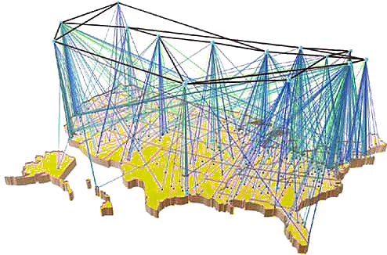


The Internet is nowadays a complicated technology…
The internet is a key infrastructure where different technologies are combined to offer a plethora of services. It’s horribly complicated.
We sorely miss the technology to understand what is happening in the network and to optimize its performance and utilization.

Slide 4
mPlane goals
https://www.ict-mplane.eu
About the design and demonstration of a “measurement plane for the Internet”
  Large scale
    Vantage points on a worldwide scale
    Integrate multiple measurement technologies
  Intelligent
    Automate/simplify the process of “cooking” raw data
    Provide root-cause-analysis capabilities
  Flexible
    Offers APIs to enable integration
    Not strictly bounded to specific “use cases”

Slide 5



























mPlane consortium
Coordinator
WP7
16 partners
  3 operators
  6 research centers
  5 universities
  2 small enterprises
Marco Mellia
POLITO
Saverio Nicolini
NEC
Dina Papagiannaki
Telefonica
WP1
WP2
Ernst Biersack
Eurecom
Brian Trammell
ETH
Tivadar Szemethy
NetVisor
WP6
WP5
Andrea Fregosi
Fastweb
Dario Rossi
ENST
Fabrizio Invernizzi
Telecom Italia
WP3
WP4
Guy Leduc
Univ. Liege
Pietro Michiardi
Eurecom
Pedro Casas
FTW

Slide 6


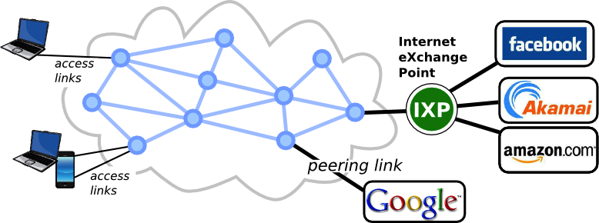
mPlane components
active probe
passive probe
data
control

Slide 7






mPlane WPs’organization
WP8 - Project Management
WP7 - Dissemination, Exploitation and Standardization
WP1
Use Cases, Requirements and Architecture
WP5
Integration, Deployment, Data Collection, Evaluation
WP6
Demonstration
WP4 - mPlane Supervisor: Iterative
and Adaptive Analysis (supervision layer)
WP3 - Large-scale Data Analysis
(Repository and Analysis Layer)
WP2 – Programmable Probes
(Measurement Layer)

Slide 8
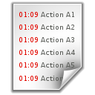








mPlane layers
  Measurement Layer
WP2
mInterface
Raw data
mInterface
mInterface
mInterface
mInterface
mInterfacee
mProbe 1
mProbe 2
mProbe N
legacyProbe 1
legacyProbe 2
legacyProbe N

Slide 9







mPlane layers
Data collection
& processing
Repository and Analysis Layer
legacyDB 1
legacyDB 2
legacyDB N
WP3
mPlane
Repository
DBStream
Blockmon
  Measurement Layer
WP2
mInterface
Raw data
mInterface
mInterface
mInterface
mInterface
mInterfacee
mProbe 1
mProbe 2
mProbe N
legacyProbe 1
legacyProbe 2
legacyProbe N

Slide 10

mPlane layers
Supervisor
Data collection
& processing
Repository and Analysis Layer
legacyDB 1
Coordination
legacyDB 2
Intelligent Reasoner
WP4
legacyDB N
WP3
Analysis Modules
Module 1
Module 2
Module N
mPlane
Repository
DBStream
Blockmon
  Measurement Layer
WP2
mInterface
Raw data
mInterface
mInterface
mInterface
mInterface
mInterfacee
mProbe 1
mProbe 2
mProbe N
legacyProbe 1
legacyProbe 2
legacyProbe N

Slide 11
Iterative analysis
Alarm!
Setup the system to monitor a service
(e.g., quality of YouTube streaming)
passive probe reports an anomaly
start RCA
  crosscheck on other passive probes
  crosscheck with larger time scale
  crosscheck with active probing
  Is because of
    DNS
    Routing
    Others?
Repository
Supervisor
Raw data
Found

Slide 12
Some of mPlane use cases
FOCUS
Anomaly detection and root cause analysis in large-scale networks (Polito + FTW)
Quality of Experience for web browsing (Eurecom)
Mobile network performance issues (Telefonica)
Verification and certification of service-level agreements (FUB)
Content popularity and caching strategies
Etc.
The Internet is used by different entities (end-users, operators,
content providers, regulation agencies, etc.)
WP6 – Demonstration, is about showing the actual usage of mPlane
(at least) for the defined use cases

Slide 13



Other ongoing efforts for measurement frameworks
FP7 European projects
    Integrated Project (IP)
    3 years → 2 left, 16 partners, 11.2 Meuros
  “From global measurements to local management”
    Specific Targeted Research Projects (STReP)
    3 years → 2 left, 10 partners, 3.8 Meuros
    Build a measure framework out of probes
IETF, Large-Scale Measurement of Broadband Performance (lmap)
  Standardization effort on how to do broadband measurements
    Defining the components, protocols, rules, etc.
  It does not specifically target adding “a brain” to the system
… is like a “mPlane use case”
Strong similarities for the architecture core
Brian Trammell
ETH

Slide 14
Outline
1. mPlane introduction
2. Monitoring CDN
“Continuous analytics for traffic monitoring and applications to CDN”
A.Bar, A. Finamore, I. Bermudez, L. Golab, M.Mellia, P.Casas,
Submitted to IFIP Networking 2014

Slide 15
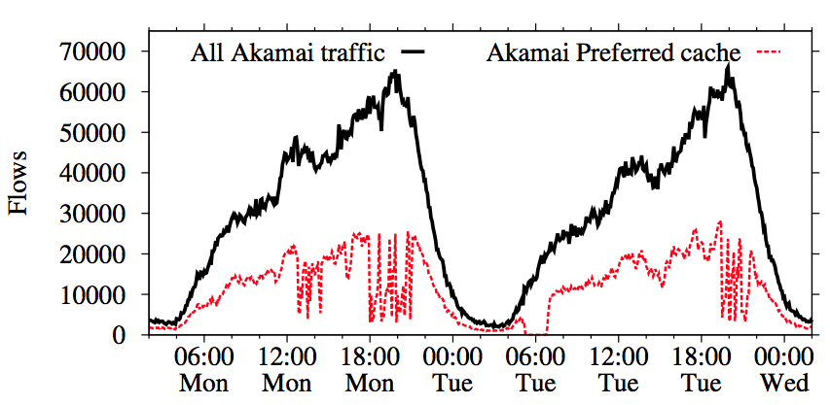
CDN makes complicated things
Focusing on vantage point of ~20k ADSL customers
1 week of HTTP logs (May 2012)
  Content served by Akamai CDN
  The ISP hosts an Akamai “preferred cache” (a specific /25 subnet)
?
?
?

Slide 16
Reasoning about the problem
Q1: Is this affecting specific services?
Q2: Are the variations due to “faulty” servers?
Q3: Was this triggered by CDN performance issues?
Etc…
How to automate/simplify this reasoning?
DBStream:
Continuous big data analytics
Flexible processing language
Full SQL processing capabilities
Processing in small batches
Storage for post-mortem analysis

Slide 17
Q1: Is this affecting a specific service?
NO
Select the top 500 Fully Qualified Domain Names (FQDN) served by Akamai
Check if they are served by the preferred cache
Repeat every 5 min
The anomaly is not related to
individual services
Services not
served by the preferred cache
Services hosted
by the preferred
cache, except
during the
anomaly
The two set of FQDN are “not orthogonal”
Same results extending to more than 500 FQDN

Slide 18
Q2: Are the variations due to “faulty” servers?
NO
Compute the traffic volume per IP address
Check which are the active IPs during the disruption
Repeat each 5 min

Slide 19
Q3: Was this triggered by CDN performance issues?
Compute the distribution of server elaboration time
  It is the time between the TCP ACK of the HTTP GET and the reception of the first byte of the reply
Focus on traffic of the /25 preferred subnet
Compare the quartiles every 5 min
client
passive
probe
server
SYN
SYN+ACK
YES!!
NO!!
Performance decreases
right before the anomaly
@6pm
ACK
GET
ACK
query processing
time
DATA

Slide 20
Reasoning about the problem
NO
Q1: Is this affecting only specific services?
Q2: Are the variations due to “faulty” servers?
Q3: Was this triggered by CDN performance issues?
What else?
  Other vantage points report the same problem? YES!
  What about extending the time period?
    The anomaly is present along the whole period we considered
    On going extension of the analysis on more recent data sets (possibly exposing also other effects/anomalies)
  Routing? TODO → route views
  DNS mapping? TODO → RipeAtlas + ISP active probing infrastructure
Other suggestions are welcomed ☺
NO
NO

Slide 21
With the mPlane hat on…
Probes
  Passive monitoring at the edge (i.e., residential customers)
  Passive monitoring at the core (i.e., peering links)
  Active monitoring (e.g., DNS mapping, network paths, etc.)
  End-users reports (e.g., browser plugins)
Other data sources:
  Routing tables
  MaxMind Orgname DB / whois
Methodologies:
  Anomaly detection algorithms
  Geolocation

Slide 22
Conclusions
mPlane aim to simplify network monitoring practices
  First SW libraries will be released within the first half of the year
Open for collaborations
  Collaboration Institutions (CI)
    CAIDA, Mlab, Orange Lab Poland, Endace, etc.
  Other (less formal) ways are welcomed as well ☺

Slide 23
?? || ##
Alessandro Finamore – Politecnico di Torino
<alessandro.finamore@polito.it>

