Slide 1
§
Project acronym: mPlane
Project full title: “mPlane – an Intelligent Measurement Plane for Future Network and Application Management”
Grant agreement no: 318627
Staring Date: November 1st 2012
Total Cost: 11,274,908.00Euros
Duration: 3y
Partners: 16
Coordinator: Prof. Marco Mellia – Politecnico di Torino - IT

Slide 2
mPlane motivation
The Internet is a global interconnection of networks
No single organization operates, administers or governs it
It is robust thanks to its diversity, but it is vulnerable and fragile
In case of “failure”, who can tell what’s going wrong?
Each ISP may have a figure of what happens inside its network
But what if the failure depends on other ISPs? Or on the content provider? Or on the CDN? Or on user equipment?
Today, the web is a tangle
Nobody really understands what happens today in the Internet
How to predict what will happen tomorrow?
We need an intelligent system that collects, analyzes, provides visibility to support better management: an oracle that provides answers

Slide 3
mPlane in a slide
Build a distributed, open, standard measurement infrastructure for the Internet
Probes (WP2) – get the data
Build on existing tools/methodologies
Offer a flexible, programmable, open platform to run and collect passive, active, hybrid measurement
Repositories (WP3) – store and preprocess the data
Collect measurement in a standard way
Pre-process large amounts of data in efficient ways
Grant access to interested parties (ISP, content providers, end-users, regulation agencies, etc.) subject to authorization rules
Intelligent reasoner (WP4) – dig into the data
Mine automatically the data and extract useful information
Help in drilling down to the root cause of a problem

Slide 4
mPlane in a picture
Supervisor
Repository and Analysis Layer
legacyDB 1
legacyDB 2
Intelligent Reasoner
WP4
legacyDB N
WP3
Analysis Modules
Module 1
Module 2
Module N
mPlane
Repository
Measurement Layer
WP2
mInterface
mInterface
mInterface
mInterface
mInterface
mInterface
mProbe 1
mProbe 2
mProbe N
legacyProbe 1
legacyProbe 2
legacyProbe N

Slide 5
mPlane WPs’organization
WP8 - Project Management
WP7 - Dissemination, Exploitation and Standardization
WP1 Use Cases, Requirements and Architecture
WP5 Integration, Deployment, Data Collection, Evaluation
WP6 Demonstration
WP4 - mPlane Supervisor: Iterative
and Adaptive Analysis (supervision layer)
WP3 - Large-scale Data Analysis (Repository and Analysis Layer)
WP2 – Programmable Probes
(Measurement Layer)

Slide 6
mPlane objectives
mPlane Mission and S/T Objectives | Benchmarks
1. (M) Improve knowledge of the state of the Internet and enable better network management and operations | Improvements in terms of capabilities and time to perform the troubleshooting documented in the assessment and evaluation deliverables (WP5).
2. (M) Increase the transparency of the Internet | Use cases that exploit the transparency provided by mPlane documented in the assessment and evaluation deliverables (WP5).
6. (M) Offer the research community a large and well-defined set of measurements coupled with a standard and open platform | Probes and repositories open for the research community (following the applicable privacy regulations).
1. (S/T) The definition of an architecture for the mPlane platform | Interface definition to interact with existing/emerging/novel standards (WP1)
5. (S/T) The prototyping and demonstration of mPlane capabilities and benefits | WP5 and WP6 deliverables documenting the mPlane prototype and demonstrator.

Slide 7
mPlane impact
# | Expected impact
1 | Strengthened positioning of European industry in the fields of Future Internet technologies, mobile and wireless broadband systems, optical networks, and network management technologies.
2 | Developing the technology for the future generations of the European high-speed broadband and mobile network infrastructure.
3 | Increased economic and energy efficiency of access/transport infrastructures (cost/bit).
4 | Contributions to standards and regulation as well as the related IPRs, with a predominant role for Europe in standardization bodies and fora.
5 | Industry adoption of integrated all optical networks and of spectral-efficient broadband wireless systems, novel Internet architectures and technologies.

Slide 8
mPlane partners
Prof. Marco Mellia (PoliTo) Project Coordinator
Dr Saverio Niccolini (NEC)
Technical Coordinator
Prof. Ernst Biersack (Eurecom)
Prof.Pietro Michiardi (Eurecom)
Prof. Dario Rossi (ENST)
Prof. Laurent Mathy (Univ.Liege)
Prof. Bennoit Donnet (Univ.Liege)
Prof. Bernhard Plattner (ETH)
Dr. Brian Trammel (ETH)
Prof. Fabio Ricciato (FTW)
Dr. Pedro Casas (FTW)
Dr. Dina Papagiannaki (TID)
Dr. Giovanna Carofiglio (ALU)
Dr. Fabrizio Invernizzi (TI)
Dr. Rolf Winter (Hochschule Augsburg)
…
…
Consortium

Slide 9
Collaborating Institutions
mPlane foresees the collaboration with external partners
To strengthen the standardization effort in mPlane
To allow larger deployment of the mPlane system
To enable external partners to get in touch with mPlane technology
Collaborating institutions have no commitment
No bureaucracy, no deliverable, no deadline
They can have access to results and technology preview
They can collaborate with partners
They get no funding

Slide 10
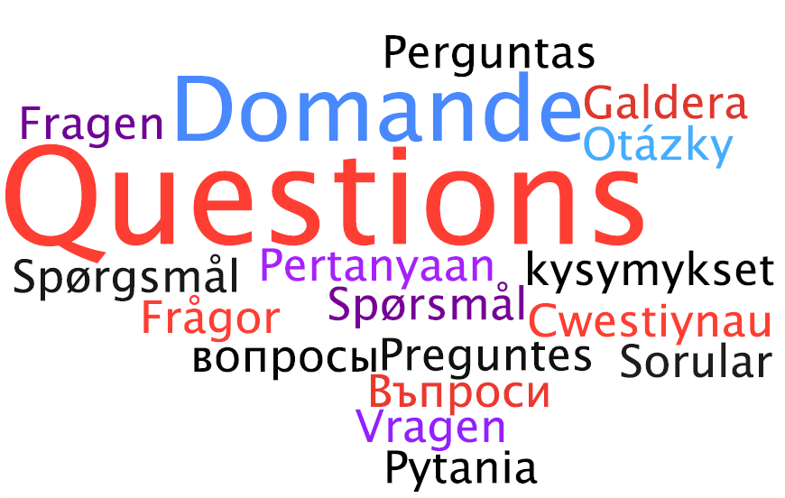

Slide 11
§
Project acronym: mPlane
Project full title: “mPlane – an Intelligent Measurement Plane for Future Network and Application Management”
Grant agreement no: 318627
Staring Date: November 1st 2012
Total Cost: 11,274,908.00Euros
Duration: 3y
Partners: 16
Coordinator: Prof. Marco Mellia – Politecnico di Torino - IT

