Slide 1
mPlane – Building an Intelligent Measurement Plane for the Internet
Maurizio Dusi – NEC Laboratories Europe
maurizio.dusi@neclab.eu
NSF Workshop on perfSONAR based Multi-domain
Network Performance Measurement and Monitoring
February 20-21, 2014

Slide 2

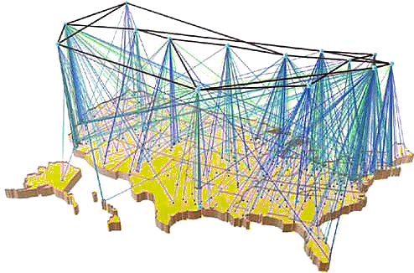


The Internet is nowadays a complicated technology…
The internet is a key infrastructure where different technologies are combined to offer a plethora of services. It’s horribly complicated.
We sorely miss the technology to understand what is happening in the network and to optimize its performance and utilization.

Slide 3
Outline
mPlane: a measurement plane for the Internet
  architecture
mPlane in practice
  DaaS troubleshooting
  Monitoring Akamai CDN

Slide 4











The EU project mPlane
https://www.ict-mplane.eu
About the design and demonstration of a measurement plane for the Internet
  A distributed infrastructure for network measurement
  … which perform passive and active measurements, continuously or on-demand, at a wide variety of scales
  … with built-in support for iterative measurement and automated iteration.
16 European partners
In three years! (since 11/2012)
  → support easy integration of
  existing technology

Slide 5



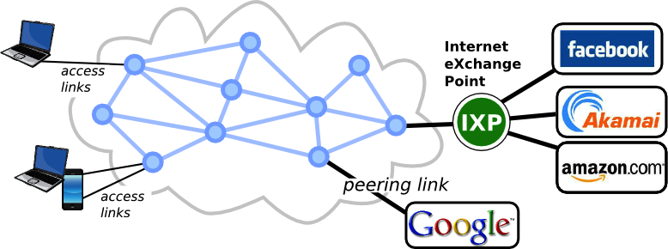

mPlane components
active probe
DBStream
passive probe
data
Blockmon
control

Slide 6
Architecture Overview
Each component
  advertise capabilities
  perform measurements/ analyses given specifications
  return/export results
Measurements completely defined by the types of data they produce and parameters they require

Slide 7
Example Capability: ping
capability: measure
parameters:
start.ms: now...+inf
end.ms: now...+inf
source.ip4: 10.2.3.4
destination.ip4: *
period.s: 1...60
results:
- delay.twoway.icmp.ms.min
- delay.twoway.icmp.ms.mean
- delay.twoway.icmp.ms.max

Slide 8
Example Specification: ping
specification: measure
parameters:
start.ms: 2014-01-20 09:25:00
end.ms: 2014-01-20 09:26:00
source.ip4: 10.2.3.4
destination.ip4: 10.4.5.6
period.s: 1
results:
- delay.twoway.icmp.ms.min
- delay.twoway.icmp.ms.mean
- delay.twoway.icmp.ms.max

Slide 9
Example Result: ping
result: measure
parameters:
start.ms: 2014-01-20 09:25:01.135
end.ms: 2014-01-20 09:26:01.136
source.ip4: 10.2.3.4
destination.ip4: 10.4.5.6
period.s: 1
results:
- delay.twoway.icmp.ms.min
- delay.twoway.icmp.ms.mean
- delay.twoway.icmp.ms.max
resultvalues:
- - 39
- 44
- 73

Slide 10



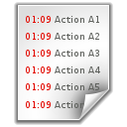
mPlane workflow: iterative analysis
Alarm!
Setup the system to monitor a service
(e.g., quality of YouTube streaming)
passive probe reports an anomaly
start Root Cause Analysis
  crosscheck with passive probes
  crosscheck on larger time scale
  crosscheck by active probing
  Is because of
    DNS
    Routing
    Others?
Reasoner
Repository
Supervisor
Found
Raw data

Slide 11
mPlane inter-domain measurements
Each domain collects and owns measurements
Multi-domain measurements handled as communications among supervisors

Slide 12







mPlane interoperability
We are working on an adapter between mPlane and the tool native interfaces
Using of existing standards
  Measurements as capabilities
    Definitions taken from the IETF IPPM WG
  Partially structured namespace
    [base].[modifiers].[units].[aggregation]: [primitive]

Slide 13
Some of mPlane use cases
FOCUS
Desktop as a Service troubleshooting
Anomaly detection and root cause analysis in large-scale networks
Quality of Experience for web browsing
Mobile network performance issues
Verification and certification of service-level agreements
Content popularity and caching strategies
FOCUS

Slide 14
mPlane use case I:
Desktop as a Service troubleshooting

Slide 15
Desktop as a Service troubleshooting
Detecting the Quality of Experience of users accessing content using Desktop-as-a-Service solutions through thin-client connections

Slide 16
Workflow
Probes send info about the thin-client connection to the repository
The Reasoner
  classifies the connection (application on top) [1]
  correlates application with network conditions along the path
  monitors users’ QoE
      Poor? start root cause analysis (iterative measurements)
      e.g., migrate virtual server closer to the user
Alarm!
[1] M. Dusi et al., “A closer look at thin-client connections: statistical application identification for QoE detection”, IEEE Communication Magazine, 2012

Slide 17
mPlane use case II:
Monitoring Akamai CDN

Slide 18

CDN Daily pattern:
Preferred cache serve ~30% of traffic at peak time
Occasional drop in the preferred chace selection
Abrupt changes trigger the iterative analysis coordinated by the Reasoner

Slide 19
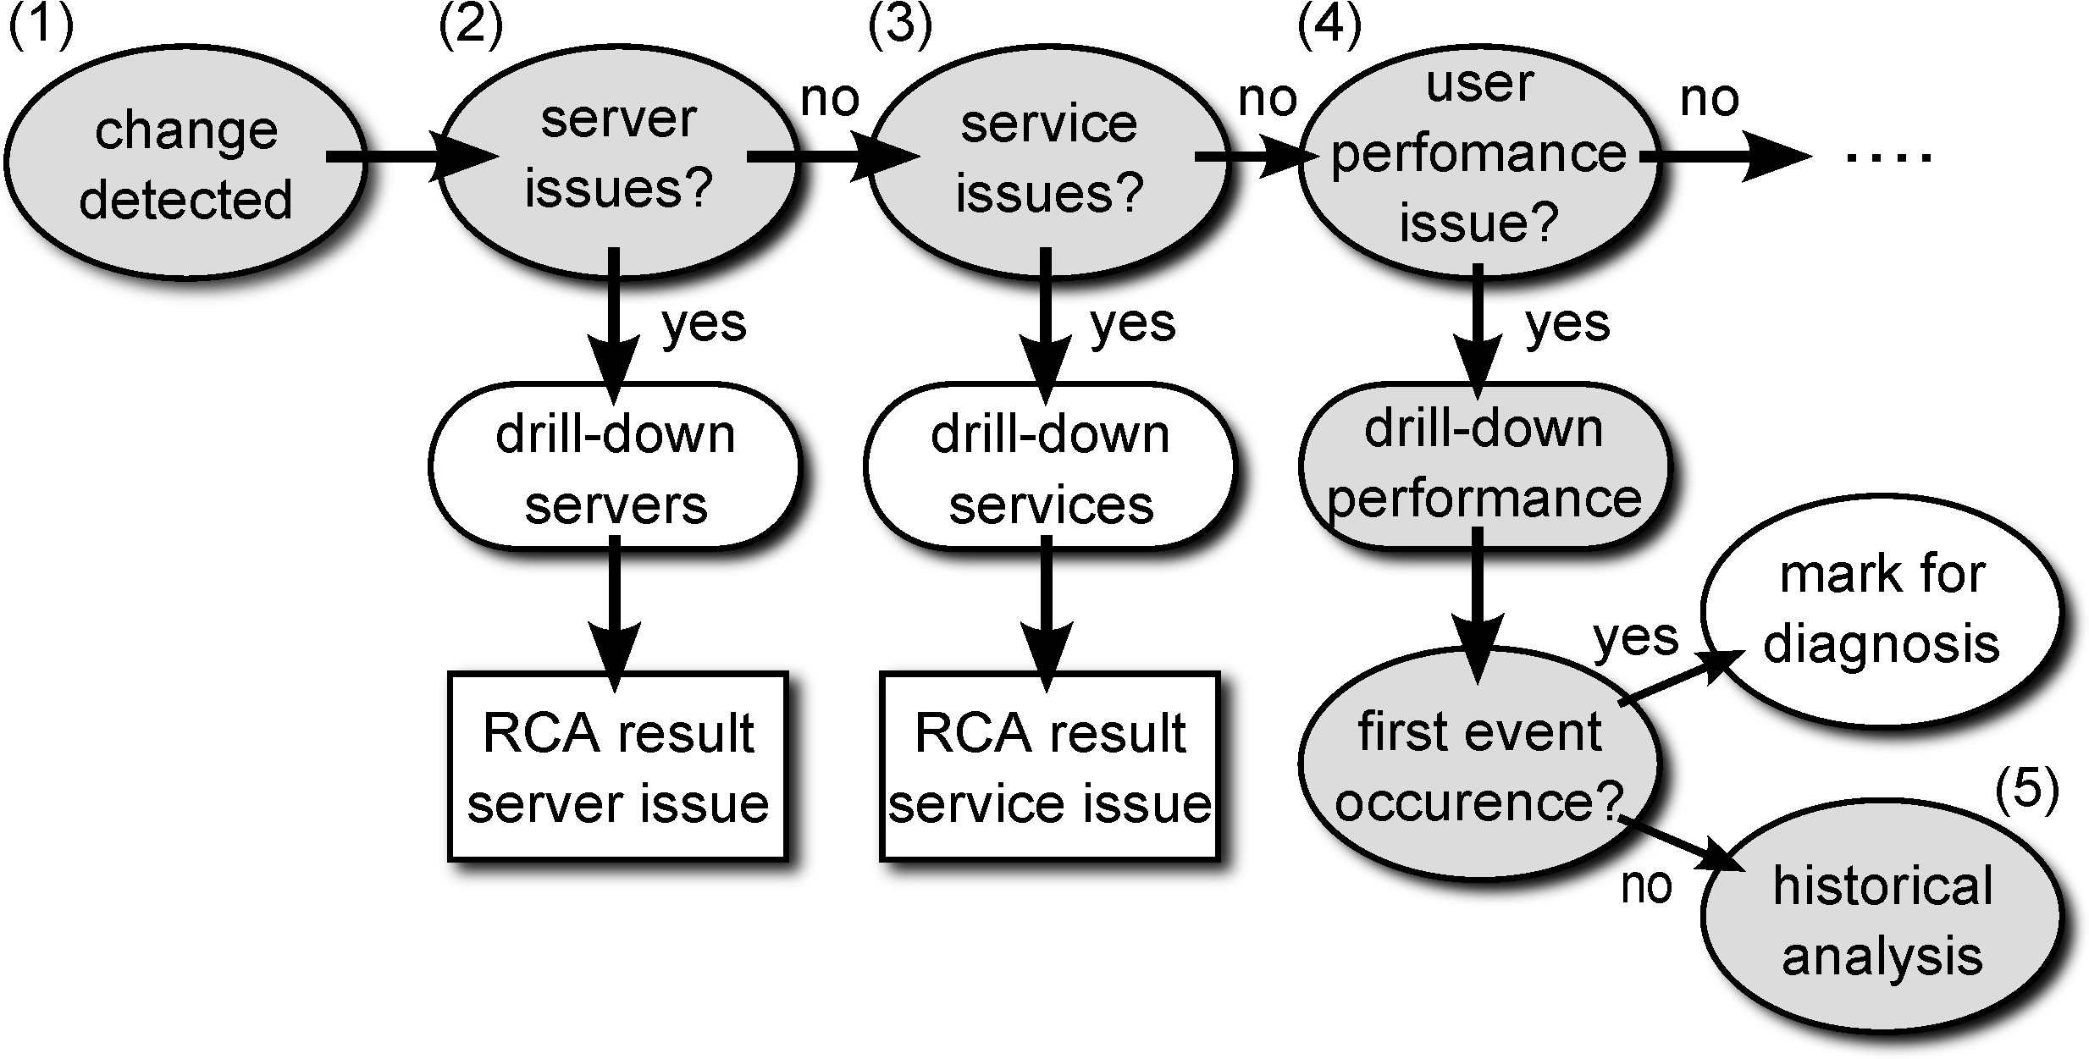
Shift in the Akamai served traffic
Iterative analysis performed by the reasoner
  Diagnosis performed following a tree-like structure

Slide 20
Single server issue?
NO
Compute the traffic volume per IP address for every 15m time intervals
40 servers always active handle 62% of traffic

Slide 21
Service^{(*)} issue?
NO
Select the top 500 services served by Akamai
  Order by frequency
  Repeat for each 5m time interval
(*) Service == FQDN

Slide 22
CDN performance issues?
For services served by Akamai preferred cache
  Compute the distribution of server elaboration time
    time between the TCP ACK of the HTTP GET and the reception of the first byte of the reply
  Plot percentiles every 5m of time
NO!!!
YES!!

Slide 23
What else?
Final root cause analysis not identified
  Calls for having mPlane deployed for on-line iterative analysis
  Other vantage points report the same problem
Extending the time period?
Routing?
DNS mapping?
Suggestions?

Slide 24
Conclusions
mPlane aims at simplifying network monitoring practices
  Supervisor focused on iterative measurements
    Troubleshooting support
  Open source release of software
    Tstat, Blockmon, QoF, tracebox
  Maximum reuse of existing measurement tools
    First software libraries will be released soon
Collaborations are welcome!
Info @ http://www.ict-mplane.eu

Slide 25
Thanks!
Maurizio Dusi – NEC Laboratories Europe
maurizio.dusi@neclab.eu

